Slide 1
Sifting Through the Stereotypes: Connecting with Gen Z Students
Lilly Conference: Teaching for Active and Engaged Learning
San Diego, February 2020
Eileen Kogl Camfield
CETL Faculty Associate, UC Merced
Leslie Bayers
CTL Associate Director, University of the Pacific
Lott Hill
CTL Director, University of the Pacific
Notes:
Nothing new about complaints about young people…
20 BCE Horace – called them “a progency yet more corrupt” [than ever came before] (Book III Odes)
17th CENTURY (1624) Wise Man’s Forecast Against the Evil Time declared “Youth were never more saucy.”
18th CENTURY (1780) Thomas Sheridan descried their “total neglect of the art of speaking…[where] English is likely to become mere jargon.”
19th CENTURY (1853) Mother’s Journal described them as “full of self-conceit and admiration.”
19th CENTURY (1859) Scientific American was horrified by a “pernicious amusement of a very inferior character” (referring to chess).

Slide 2
How do you define “RIGOR”?
Notes:
How do you define rigor? Something that requires muscle, endurance, and may cause a degree of suffering to overcome? Unyielding, inflexible, austerity? A condition that makes life difficult, challenging, or uncomfortable (e.g., the rigors of a New England winter)?

Slide 3
Why do narratives matter?
Notes:
We develop identity by the stories we tell. We use narratives to make meaning, which in turn shapes our actions. FICTION CREATES FACT
Cite: neuroscience. Hardcastle, V.G. (2003). The development of the self. In G.D. Fireman, T. E. McVay, & O. J. Flanagan (Eds.), Narrative and consciousness: Literature, psychology and the brain (pp. 37-50). New York, NY: Oxford University Press.
Also, https://www.oxfordscholarship.com/view/10.1093/acprof:oso/9780195140057.001.0001/acprof-9780195140057

Slide 4
What are some of the student behaviors you’ve witnessed or heard about GenZ students, and how are those behaviors interpreted?
Notes:
I expect I can predict some of what you had to say

Slide 5
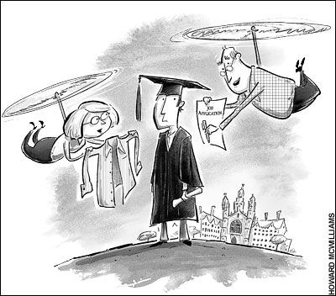
Common Narratives About Gen Z
Protected and Privileged: Helicopter/Lawnmower Parents
Tethered: iGen
Notes:
Gen Z: born mid-to-late 1990s through 2012.
Student entitlement: See Chronicle of Higher Education Dear Student column, https://www.chronicle.com/blogs/onhiring/dear-student/31004.
iGen = first generation to spend entire adolescence with SMART phone (i-Phone launched in 2007). “Digital Natives”
These are very common tales we tell to describe student behavior…

Slide 6
How might these narratives affect how we respond to student work? Consider this first sentence from a student essay:
“Most people have believed that relationships, such as friendships and romantic relationships, can be related to particular movies we would watch or from beliefs we have gained while growing up.”
Awkward
Uninteresting
Obvious
Little effort
Notes:
To what extent do these narratives skew our evaluation to the negative? Push us to find deficits?
400 college faculty = 85% make negative judgments
See also Bayers, L. & Camfield, E.K. (10 March 2018) Student shaming and the need for academic empathy. Hybrid Pedagogy. http://hybridpedagogy.org/student-shaming-academic-empathy/ .

Slide 7
Perfect is Possible
“In order to get into college, I’ve got to have a 4.6 GPA, 800s on my SATs, captain the soccer team, get elected homecoming queen, and start my own
successful non-
profit….”
Notes:
Everything is HIGH-STAKES. Everything is JUDGED. These narratives (realities) can effect how we build relationships with students and how we evaluate their work.

Slide 8
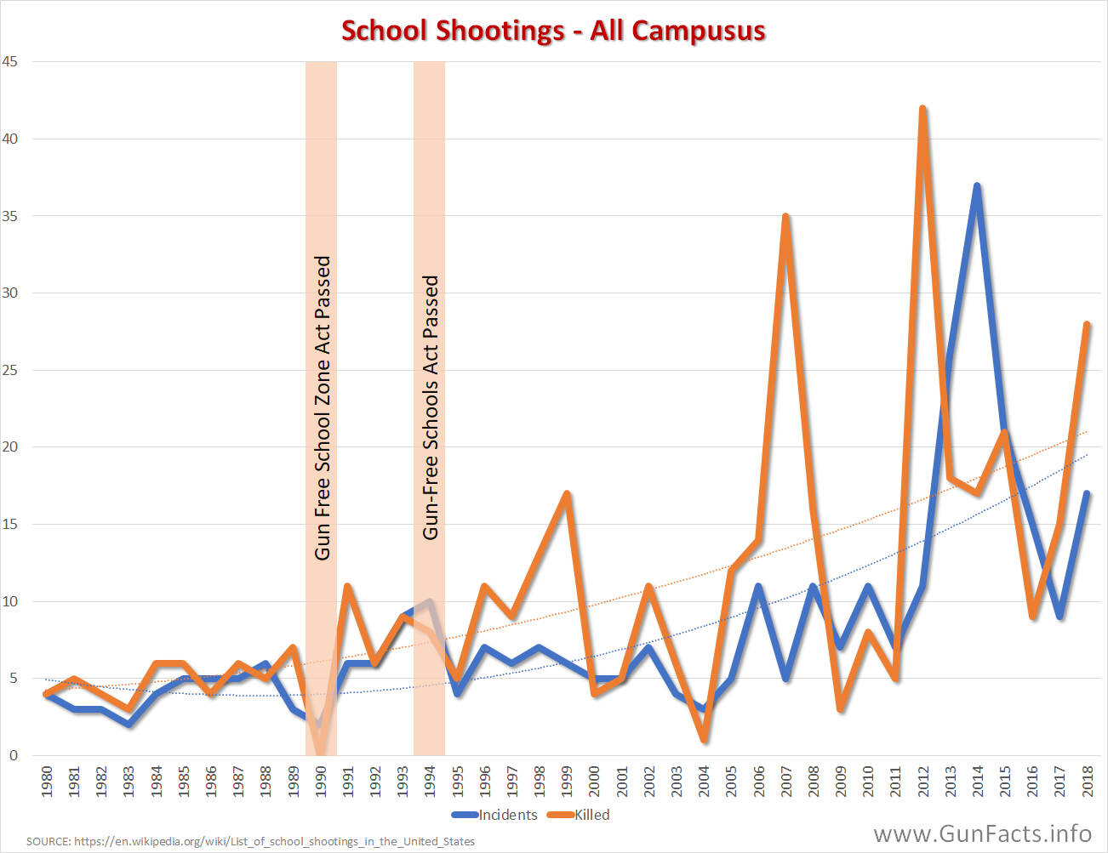
I am unsafe…
More than 4 million children endured lockdowns last school year, a groundbreaking Washington Post analysis found. The experience left many traumatized (Dec. 2018).

Slide 9
What do the Gen Z narratives have in common?
Each undermine student resilience.
Notes:
Resilience Theory: Why do some people bounce back after adversity whereas others crumble under pressure? Associated with student learning, persistence, and long-term well-being. Requires ADVERSITY… but just the right amount: Too little adversity gives us nothing to “bounce back” from; Too much adversity is crippling -- RISK FACTORS Risk factors can be offset by PROTECTIVE FACTORS [Note: Positive associations emerge after controlling for intellectual aptitude and levels of past academic preparation. Protective factors include student health centers, Thrive Institute (summer bridge), tutoring support….. What can we do in the classroom?
How might this connect back to their conceptualizations of RIGOR? THIS is what Gen Z needs!
Cite: “Resilience Theory: What Research Articles in Psychology Teach Us” https://positivepsychology.com/resilience-theory/
“Resilience Building in Students :The Role of Academic Self-Efficacy” by Simon Cassiday (2015) New Frontiers in Psychology]
A useful lens for evaluating the narratives we tell about our students…
Protected & Privileged = too little adversity Perfect is Possible = too much adversity Under Threat = too much adversity Tethered = too much AND too little adversity

Slide 10
Toxic impact on students Data drawn from four large, nationally representative surveys of 11 million Americans since the 1960s; since 2011…
Disconnection/
loneliness/
isolation
Adversarial relationships with TIME
A sense of HELPLESSNESS
Depression and anxiety
Notes:
Life is “a checklist.” 50% increased rate of major depressive disorder in teens between 2011-2015; suicide rates have doubled…
Data drawn from four large, nationally representative surveys of 11 million Americans since the 1960s… from Twenge’s 2018 book iGen: Why Today's Super-Connected Kids Are Growing Up Less Rebellious, More Tolerant, Less Happy--and Completely Unprepared for Adulthood--and What That Means for the Rest of Us
See also Camfield, E K. (2016). Mediated-efficacy: Hope for “helpless” writers. Journal of Developmental Education, 39(3), 2-11. https://files.eric.ed.gov/fulltext/EJ1130186.pdf on the dangers of learned helplessness.

Slide 11
“I find it weird that I hate writing but I love to read… Every time I have an essay assignment for a class, I become very anxious. Before I even start writing down my outline, I stress myself out over what will be good enough. It takes me hours to even write my first sentence… No doubt, I have pressed the backspace button about a million times.”
Meet Natalia
“I try my best in every assignment, but the outcome never comes out positive…The bad scores I would get from my teachers caused me to doubt myself, lowered my confidence, and caused me to panic every time I would write an essay.”
Notes:
We can see those negative traits manifest in Natalia’s narratives: anxiety, negative self-comparison, helplessness
Another way: EMPATHY connects us with students as humans; learn about their learning; get beneath the surface stereotypes….
Do this to help students build RESILIENCE

Slide 12
How do we craft counter-narratives about Gen Z that foster resilience?
Rigor That Builds Learning Muscles: standards, curricula, and assessments that provide right amount of adversity and support student growth.
Growth Mindset about students (Dweck, 2007)
Warm Demanders (Hammond, 2014)
Empathy and Community: relationships that create a sense of belonging (Strayhorn, 2012); classroom collaborations
Agency: pedagogy that empowers (Freire, 1970); inquiry-based curricula; asset-focused assessment
Academic Self-Efficacy (Bandura, 2008)
Notes:
GROWTH MINDSET ABOUT STUDENTS Note: Building a classroom community in which students are intrinsically invested is the single most effective way to activate learning and reduce distraction from phones. Provide opportunities for students to make choices; teach transparently
WARM DEMANDER (culturally responsive teaching)

Slide 13
Reframe the previous interpretation of the student behavior described on the cards.

Slide 14
Sifting Through the Stereotypes: Connecting with Gen Z Students
Lilly Conference: Teaching for Active and Engaged Learning
San Diego, February 2020
Eileen Kogl Camfield
ecamfield@ucmerced.edu
Leslie Bayers
lbayers@pacific.edu
Lott Hill
lhill@pacific.edu
Notes:
Nothing new about complaints about young people…
20 BCE Horace – called them “a progency yet more corrupt” [than ever came before] (Book III Odes)
17th CENTURY (1624) Wise Man’s Forecast Against the Evil Time declared “Youth were never more saucy.”
18th CENTURY (1780) Thomas Sheridan descried their “total neglect of the art of speaking…[where] English is likely to become mere jargon.”
19th CENTURY (1853) Mother’s Journal described them as “full of self-conceit and admiration.”
19th CENTURY (1859) Scientific American was horrified by a “pernicious amusement of a very inferior character” (referring to chess).

