Slide 1
Making Meaningful Connections
An Integrated Model for Community of Inquiry and Social Emotional Learning in Face to Face and Online Learning Environments
Notes:
K

Slide 2
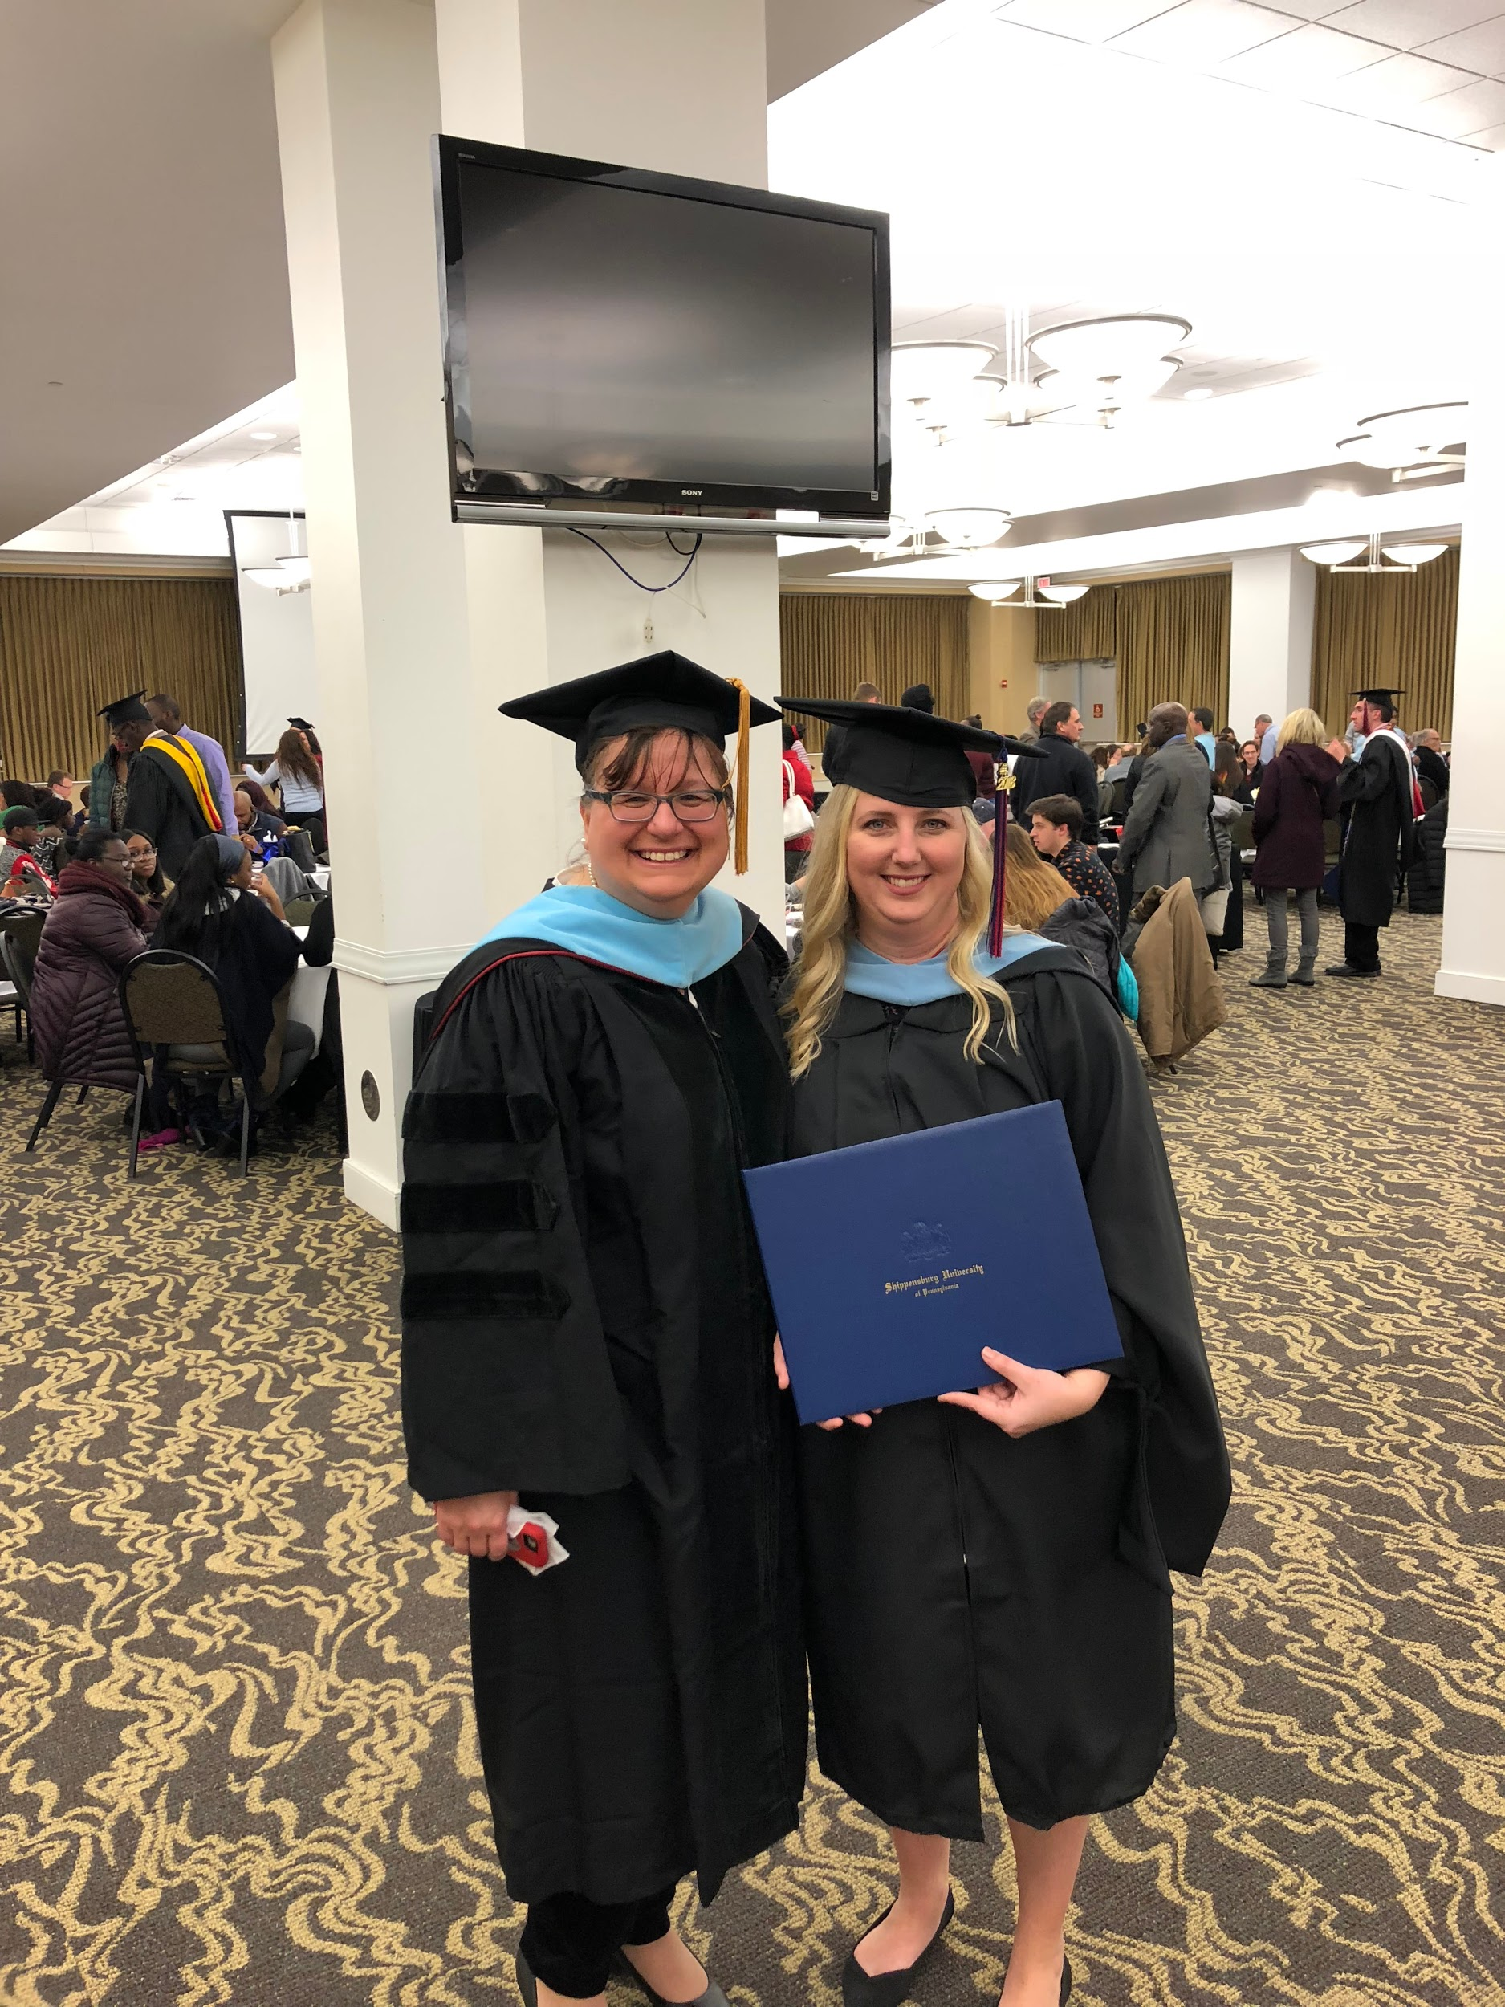
Shippensburg Students
Wendy Kubasko, Associate Professor
Department of Educational Leadership & Special Education
Full time educators (teachers, counselors, psychologists)
Blend of urban, suburban and rural school districts
Parents, coaches, teacher leaders
Face to face courses taken on nights & weekends

Slide 3
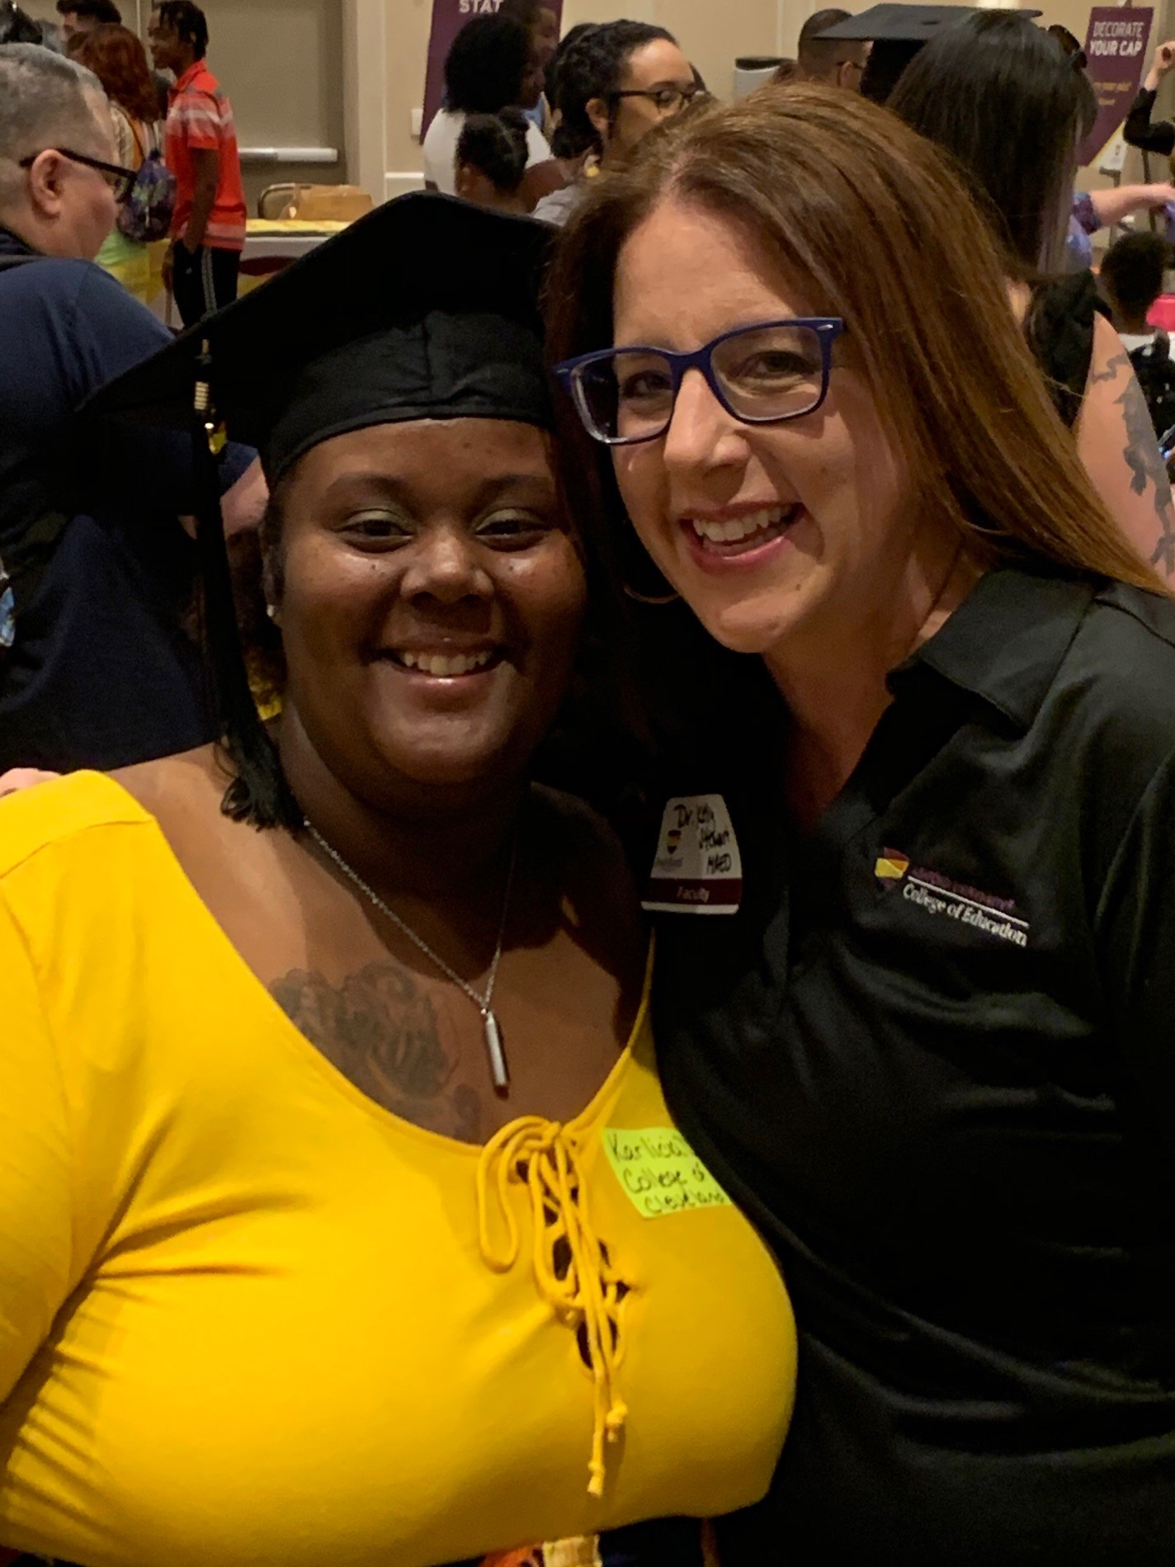
Kelly Olson Stewart, Faculty Lead Ph.D. Education,
Department of Education & Liberal Arts, College of Arts & Sciences
Ashford Students
Fully online
6 week grad courses
Majority of students over 25
Work 1-2 full-time jobs
Single parents
Variety of occupations: K-12 educators, trainers, military members/spouses, Head Start educators
Notes:
Profile of the college...typical students

Slide 5
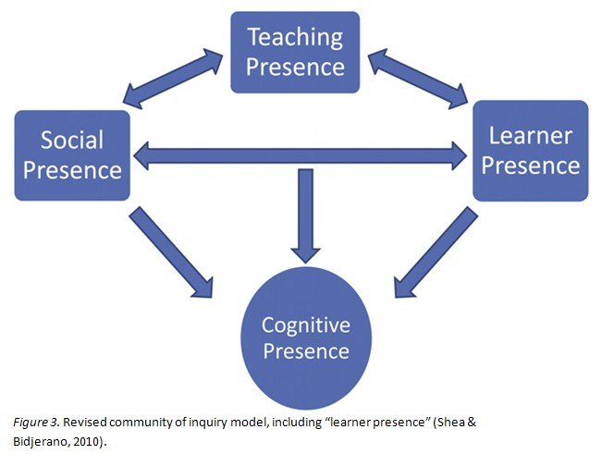
Community of Inquiry
Notes:
‘Presence’ in the online course is understood as the ability of people “to project their personal characteristics into the community, thereby presenting themselves to other participants as ‘real people’”. (Garrison, Anderson, & Archer, 2000, p. 89).
Social presence
Teaching presence
Cognitive presence

Slide 6
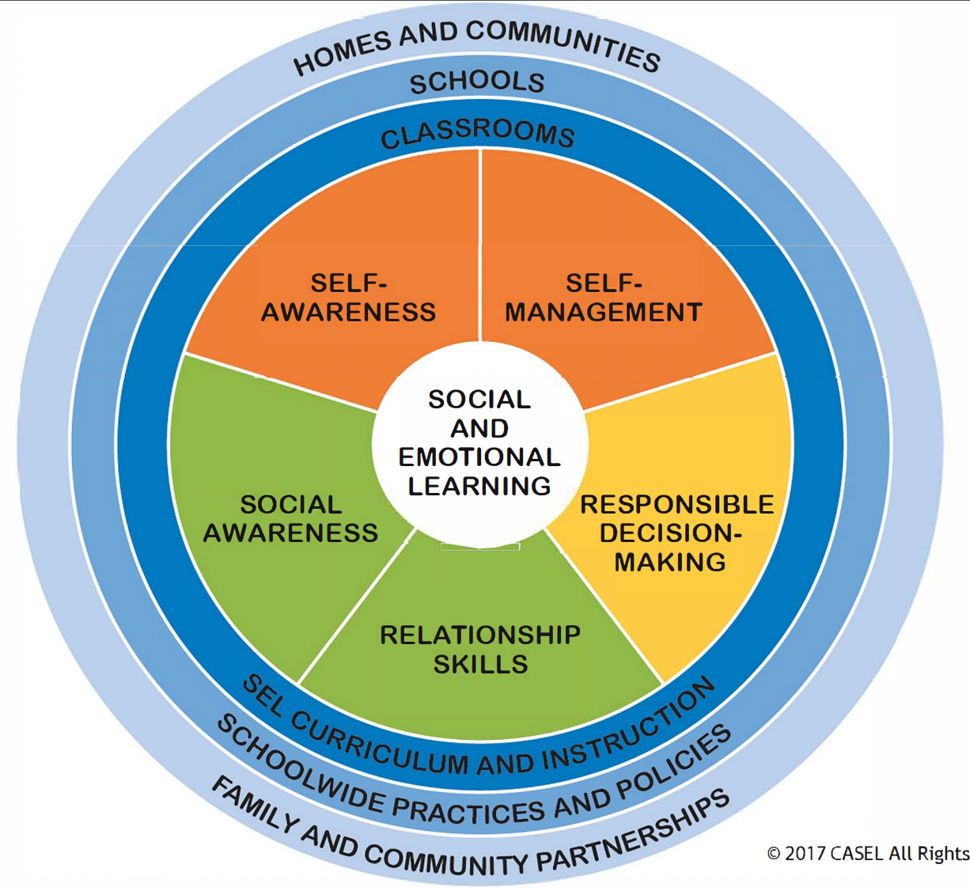
Social Emotional Learning
SELF-AWARENESS
SELF-MANAGEMENT
SOCIAL-AWARENESS
RELATIONSHIP SKILLS
RESPONSIBLE DECISION-MAKING
Notes:
CASEL

Slide 7
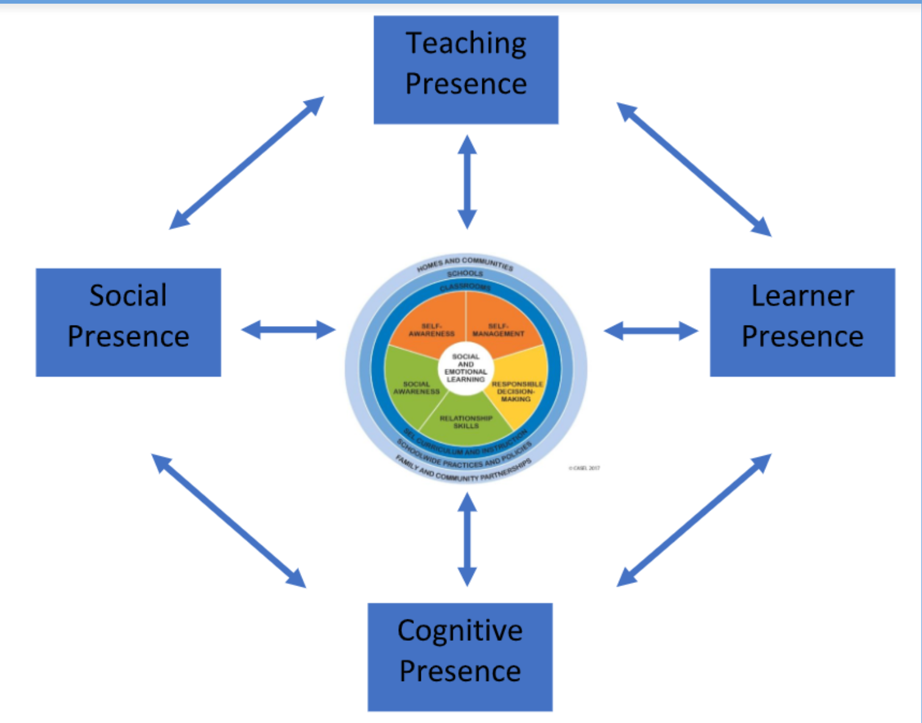
Notes:
Majeski, R. A., Stover, M., & Valais, T. (2018). The Community of Inquiry and Emotional Presence. Adult Learning, 29(2), 53–61. Retrieved from http://search.ebscohost.com/login.aspx?direct=true&AuthType=ip,sso&db=eric&AN=EJ1178764&site=ehost-live&scope=site

Slide 8
Strategies for COI & SEL
Notes:
Teaching Presence -- video check-in, Mix It Up, - SM, SeA, RS,
Learner Presence - video response, Tiny TED Talk -- SeA, SoA, RS, SM
Cognitive Presence - Guided Response Structure, Leader Life Card - DM, SoA, SeA, RS
Social Presence - Zoom, Non-Linguistic Representations

Slide 9
Teacher Presence - Mix It Up

Slide 10
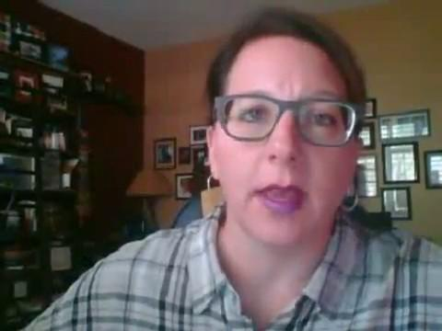
Teacher Presence - Video Check In

Slide 11
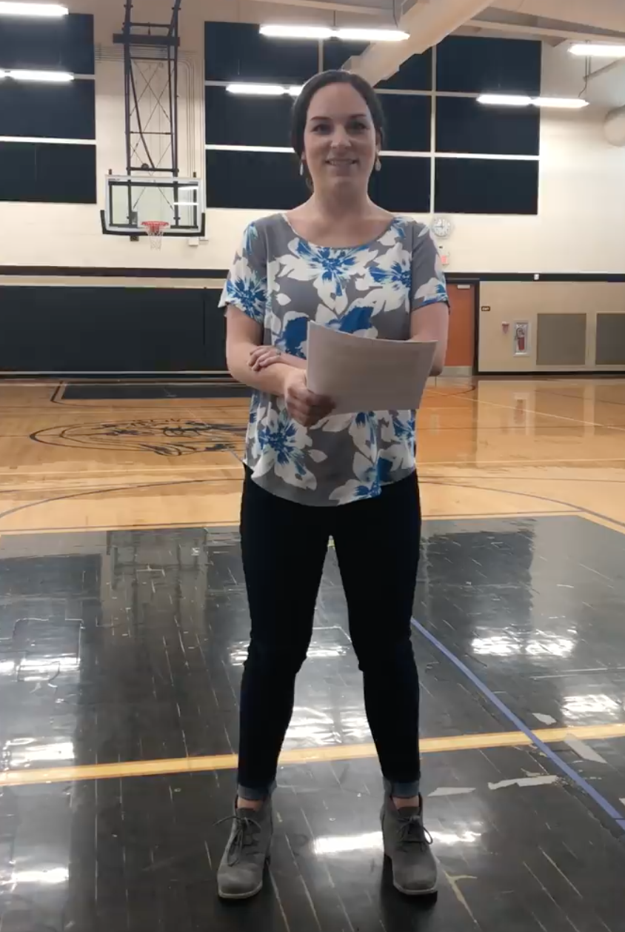
Learner Presence
- Tiny TED Talk

Slide 12
Learner Presence - Video/Audio Response
This week-I DARE you to be a MOVER, SHAKER & RISK TAKER by using the VIDEO or AUDIO option in the Discussion Board to either post your initial reply OR respond to a classmate or me!
Just click on the video camera option in the Discussion Board.
Click YES to allow your camera/audio to be used by Canvas.
Then click to record.
Then click to stop.
Preview it & click to upload. :)
Video posts or responses are best when they are UNDER 2 minutes.
Watch for a shout-out later in the week for those of you who want to earn this RISK TAKER badge. :)

Slide 13
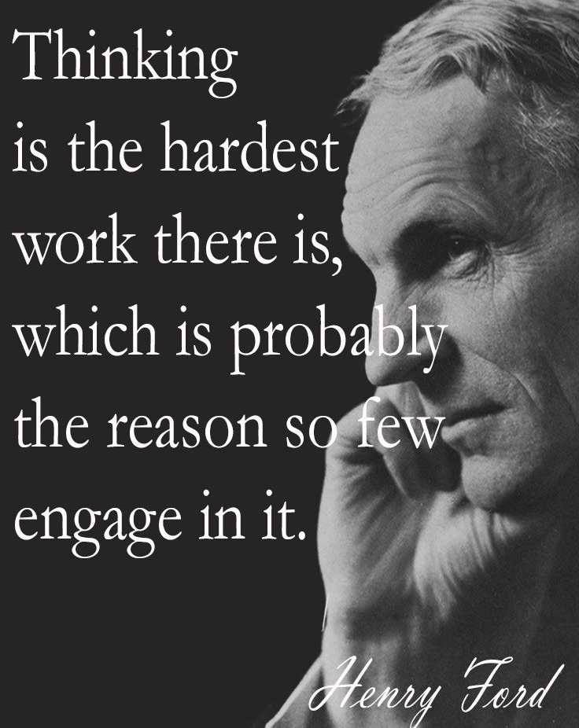
Cognitive Presence - Leader Life Card

Slide 14
Cognitive Presence - Guided Response Structure
You are a fifth grade teacher at an urban school in the Midwest where you work on a team of three other fifth grade teachers. One of your students, Kevin, is a precocious and funny child who is often seen doing the “wrong” thing in class and yet you find him endearing. Kevin comes from a tough home life where he has struggled with having a relationship with his father. Currently, Kevin lives with his mother and four siblings. His mother is frustrated with getting calls about Kevin’s behavior when she is trying to manage her other three kids and her two jobs…..

Slide 15
Cognitive Presence - Guided Response Structure
After instructing a group of 20 participants over the course of three workshop sessions, you are approached by Jane, a newly hired employee who asks for your help. She reveals that she has had difficulty following along during your instruction as you lead at the front of the room, going through your PowerPoint presentation each day. While she can hear and see what is on each slide, she is unable to remember all of the information and can’t seem to keep up when taking notes on her own paper. Her last two quizzes over the workshop resulted in scores lower than the 80% required to pass. She is not yet familiar with others at the company and has been sitting by herself during the workshops. She is fearful she will lose her job and reveals to you that she has always struggled in these types of learning situations.

Slide 16
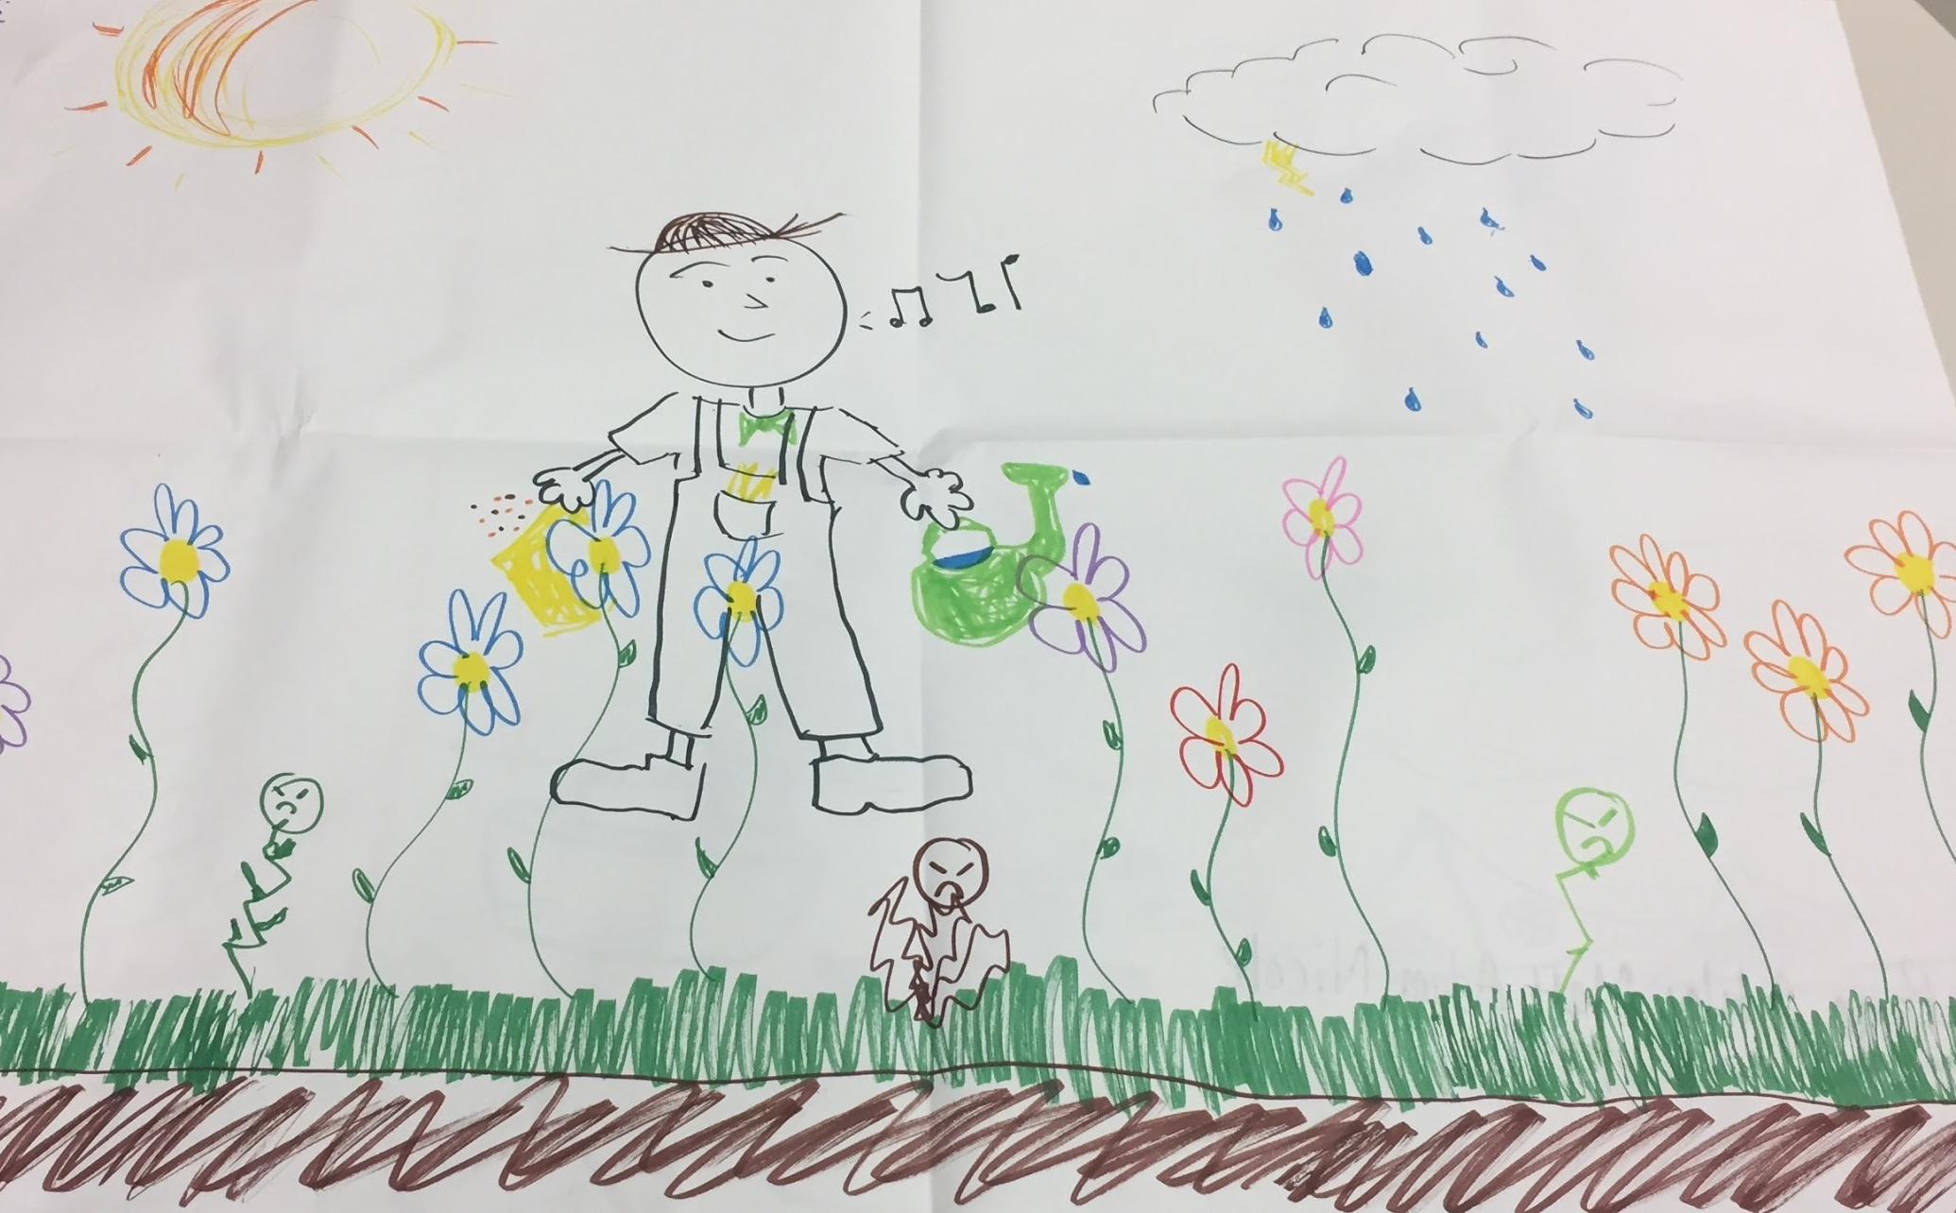
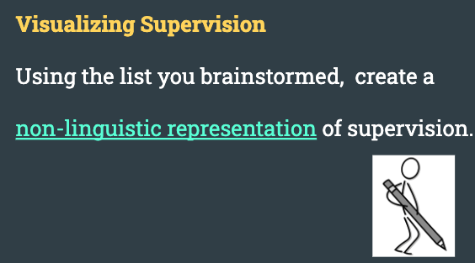
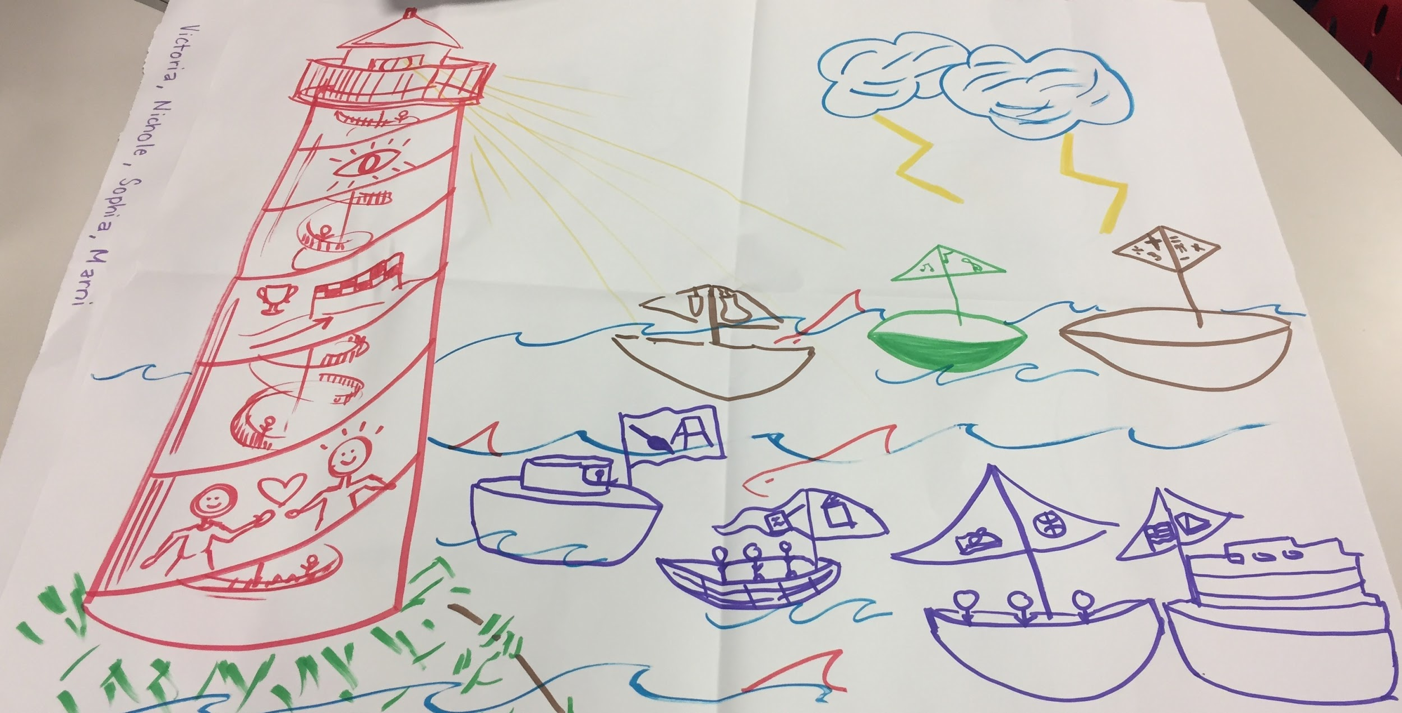
Social Presence - Non-Linguistic Representation

Slide 17
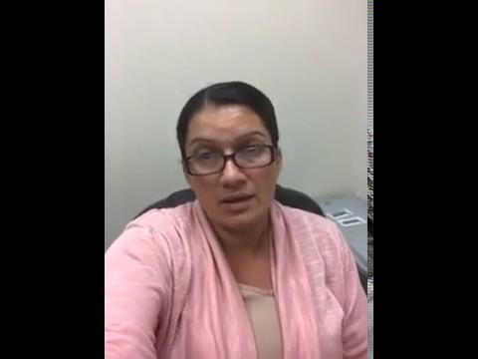
Social Presence - Zoom
Good afternoon!
We are halfway through the course! I am just touching base to see if you are doing ok and if there is anything else that I can do to help you be successful? I am grateful for your hard work & communication. Please let me know how things are going or if you have suggestions, I am open to them!! :)
Thanks,

Slide 18
Notes:
Majeski, R. A., Stover, M., & Valais, T. (2018). The Community of Inquiry and Emotional Presence. Adult Learning, 29(2), 53–61. Retrieved from http://search.ebscohost.com/login.aspx?direct=true&AuthType=ip,sso&db=eric&AN=EJ1178764&site=ehost-live&scope=site

Slide 19
Questions/Thoughts
Wendy Kubasko
wlkubasko@ship.edu
Kelly Olson Stewart
kelly.olsonstewart@ashford.edu

Slide 20
References
CASEL (2017). Collaborative for academic, social, and emotional learning. Retrieved from https://casel.org/wp-content/uploads/2017/01/Competencies.pdf
Dirkx, J. M. (2008). The Meaning and Role of Emotions in Adult Learning. New Directions for Adult and
Continuing Education, (120), 7–18. Retrieved from http://search.ebscohost.com/login.aspx?direct=true&AuthType=ip,sso&db=eric&AN=EJ824798&site=ehost-live&scope=site
Joyner, S., Fuller, M., Holzweiss, P., Henderson, S., & Young, R., (2014, September). The Importance of
Student-Instructor Connections in Graduate Level Online Courses. MERLOT Journal of Online Learning and Teaching, 10(3), 436-445.
Majeski, R. A., Stover, M., & Valais, T. (2018). The Community of Inquiry and Emotional Presence. Adult
Learning, 29(2), 53–61. Retrieved from http://search.ebscohost.com/login.aspx?direct=true&AuthType=ip,sso&db=eric&AN=EJ1178764&site=ehost-live&scope=site
Moore, A., & Mamiseishvili, K. (2012). Examining the Relationship between Emotional Intelligence and Group
Cohesion. Journal of Education for Business, 87(5), 296–302. Retrieved from http://search.ebscohost.com/login.aspx?direct=true&AuthType=ip,sso&db=eric&AN=EJ994150&site=ehost-live&scope=site
Shea, P. & Bidjerano, T. (2009). Community of inquiry as a theoretical framework to foster “epistemic engagement” and
“cognitive presence” in online education. Computers & Education, 52(3), 543-553. Elsevier Ltd. https://www.learntechlib.org/p/66906/.
Notes:
Online instructors tend to be more accepting, personable and professional
Instructor presence, including the degree to which students perceive the instructor’s care toward them, is further supported as having a degree of influence on student-instructor relationships and overall quality of the student’s learning success

