Slide 1
Interactive Online Discussion: Let us change the way we talk
David Kim, M.A.
Lecturer
IU East
Department of Criminal Justice/Political Science

Slide 2
Agenda
Advantages/disadvantages of online discussions
Example of a traditional online discussion posts
Redesign of discussion posts
Analysis (student)
Feedback from students

Slide 3
Discussion Forums (~5 minutes)
Why have you incorporated or not incorporated discussion forums in you classes?
If you have incorporated discussion forums, do you typically use them for only online courses or both online & face-to-face courses?
What are your objectives/goals of online discussions?

Slide 4
Online Discussion
Advantages
Students can participate at a time and place that suits them
Forces students to take time and contribute more developed ideas
Shy students can participate
Encourages reflection and deeper thinking
Disadvantages
Can go off topic
Some students tend to readily agree with others or paraphrase others
Respond to topics in an overall fashion
Lose motivation to participate unless they perceive ’value’ in the discussion
Technical problems

Slide 5
Traditional Online Discussion Forum
What are the three agencies of criminal justice. In your opinion, which one is the most important agency? Why?
Typical response from students:
Police, corrections, courts.

Slide 6
Traditional Online Discussion Forum
Issues with this type of format:
Students will generally have the same answer
Students responses to other students will either agree or disagree.
Does not encourage critical thinking
Students are responding to one specific topic
Grading for instructor

Slide 7
Online discussion format (~10 minutes)
As a group, please share how you format your online discussions. Please list the advantages and disadvantages of your format

Slide 8
Redesign of Discussion Posts
How I designed the discussion forum
1. Assign students to groups (typically 7-8 students per group)
2. Instructor proposes the initial question
3. First student who posts in each group, will answer the question AND propose a new question that is relevant to the topic or chapter
4. Students who post 2nd and on will answer the latest discussion post question, proposed by the student, AND propose a new question on their own

Slide 9
Redesign of Discussion Posts
Instructor propose question
Student (#1) answer (professor’s question) & propose question
Student (#2) answer (student #1) & propose question
Student (#3) answer (student #2) & propose question

Slide 10
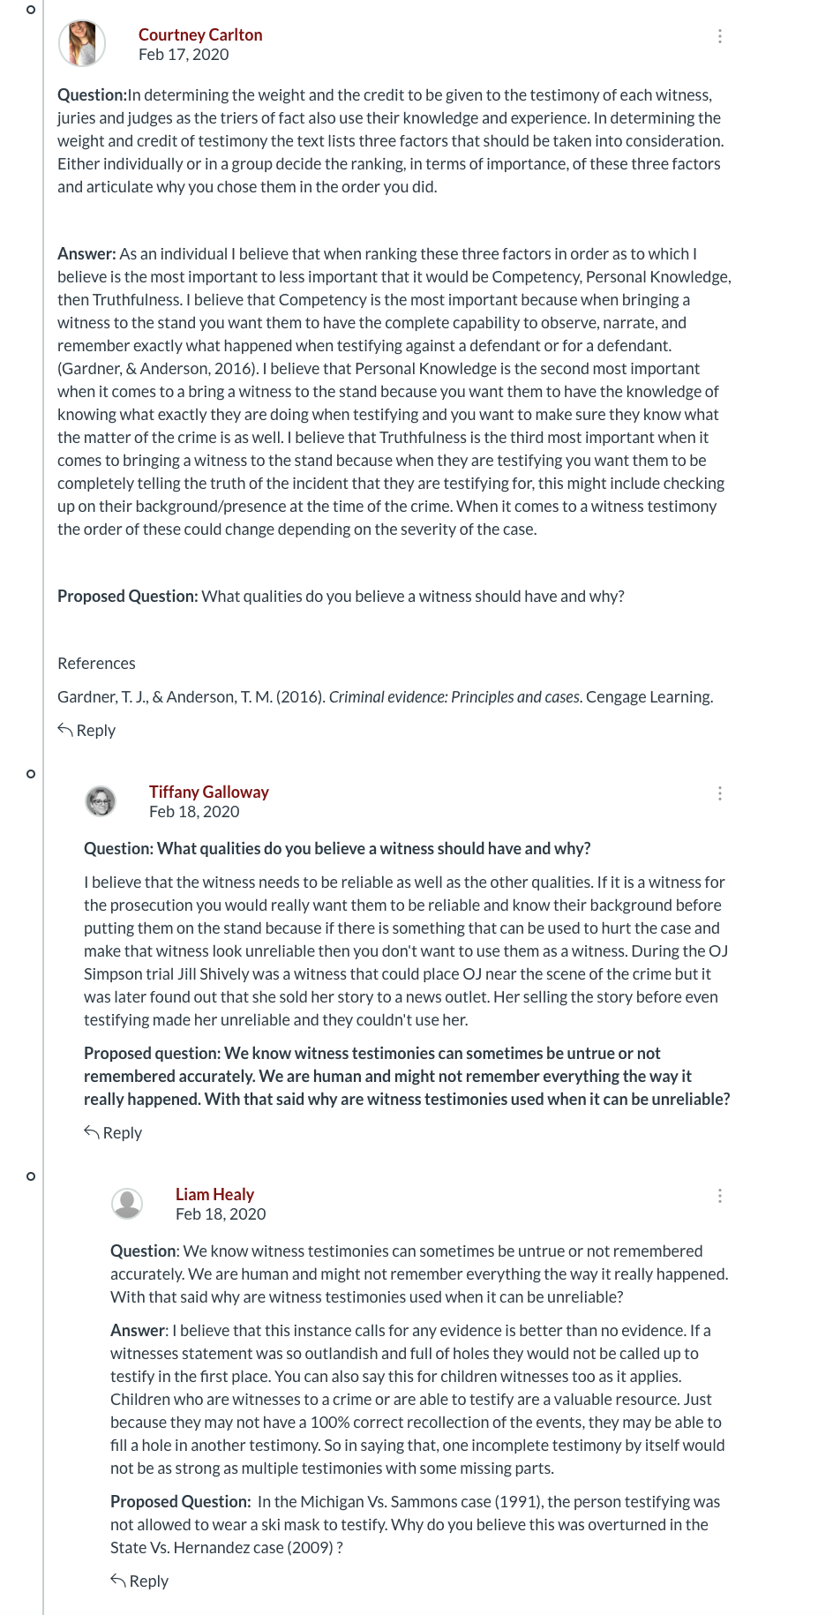
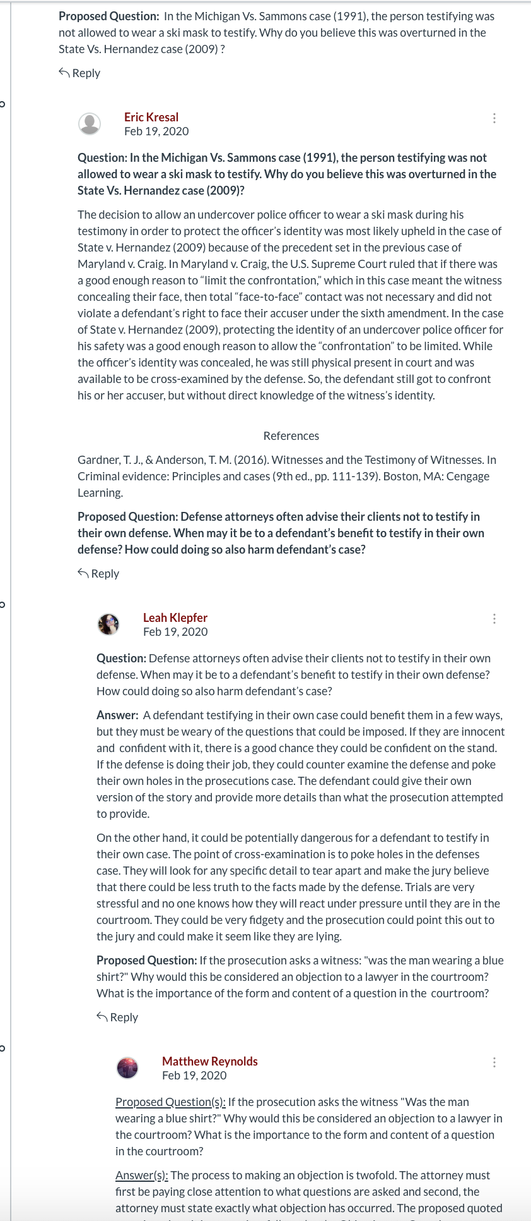
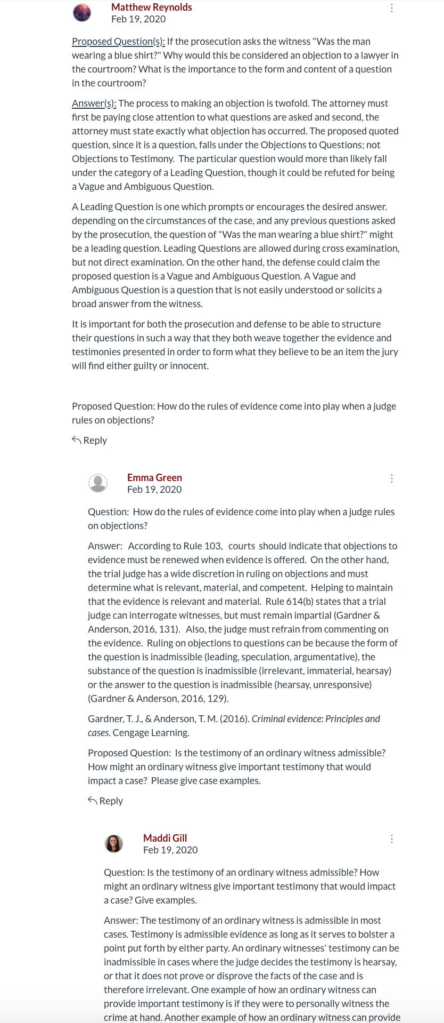

Slide 11
Group Discussion (~15 minutes)
Within your group, discuss how you can redesign it to increase student interaction and critical thinking skills
Please redesign it so that it will be similar to a face-to-face environment
Try to add a new “feature” such as video recording, group discussion posts, journal articles, etc when redesigning a new discussion forum
Due to the time limitations, redesign one of your group member’s discussion forum
We will be sharing your new ideas!

Slide 12
Discussion Post Analysis
Increase critical thinking
Increase discussion of a wide array of topics
Increase interactions
Decrease “I agree/disagree” responses
Find student interest
Evaluate student comprehension
Increase Length of Time answering/proposing DP​
Increase Attainment
Face-to-Face like atmosphere

Slide 13
Analysis of Discussion Post
 | Old Discussion Post | New Discussion Post | % Change
Interaction Rate | 6.90 | 6.97 | 1.01%
Length (time) to complete DP | 25.66 | 29.11 | 13.45%
Knowledge required to complete DP | 7.00 | 7.64 | 9.14%

Slide 14
Analysis of Discussion Post
ANSWERS | NEW FORMAT SHOULD BE IN OTHER ONLINE COURSES | NEED TO GO THROUGH MATERIALS TO ANSWER DP | NEED TO PREPARE MORE FOR DP | GAIN MORE KNOWLEDGE | HELPED UNDERSTAND MATERIAL | HELP DEVELOP/ENHANCE CRITCAL THINKING | INCREASED INTERACTION
STRONGLY DISAGREE |  |  | 2 (11%)
DISAGREE | 1 (2.4%) | 2 (4.8%) | 11 (26.2%) | 5 (11.9%) | 1 (2.4%) | 1 (2.4%) | 3 (7.1%)
AGREE | 20 (47.6%) | 23 (54.8%) | 21 (50%) | 26 (61.9%) | 25 (59.5%) | 17 (40.5%) | 20 (47.6%)
STRONGLY AGREE | 21 (50%) | 17 (40.5%) | 8 (19%)( | 11 (26.2%) | 16 (38.1%) | 24 (57.1%) | 19 (45.2%)

Slide 15
Feedback from Students
I really enjoyed the discussion post. I liked that the students made their own proposed question instead of everyone using the same question. I learned much from the discussion threads and the thoughts from other students
I really liked the different approach to discussion boards. It felt more like an actual discussion that we all kept going. It was much more beneficial in my opinion than traditional discussion boards
I liked how the discussion forums were a thread instead of everyone answering the same question like in other classes
Clever and creative discussion forum format. The online discussion forums that we completed each week were a course strength. The fact that we were tasked with answering and providing our own critically thinking questions helped me tremendously when learning and retaining the information in each chapter. Since the groups changed after every exam, you were able to get different points of view on the subjects in each chapter

Slide 16
Criticisms
At first the directions for the discussion posts were unclear.
The discussion forum format, while a nice touch, was poorly explained at first
I do not love how the discussion posts are formatted
I found the course to be well laid out other than the discussion forum. I would have preferred an assigned discussion question due each week, rather than relying on the classmates to correctly reply and post questions
The discussion post were confusing during the first two weeks of class because it was a new method being introduced but the class eventually got the concept.

Slide 17
THANK YOU
Email: dyk1@iu.edu
Please send me an email if you would like the ppt.

