Slide 1
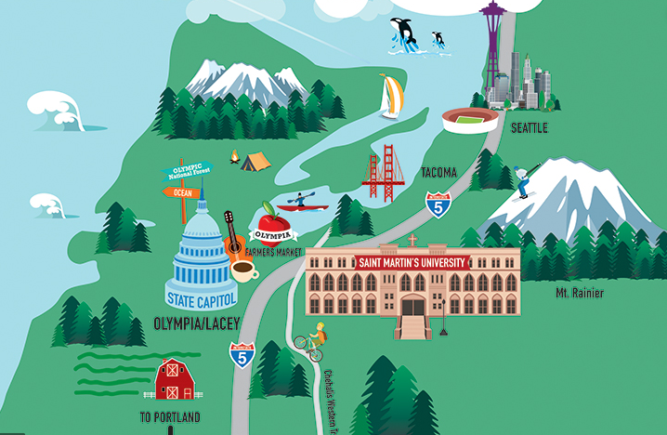
Re-evaluate and re-energize your teaching: Your students will benefit (and so will you)
Mary Jo Hartman, Ph.D.
Associate Professor of Biology
Saint Martin’s University
Lacey, WA

Slide 2
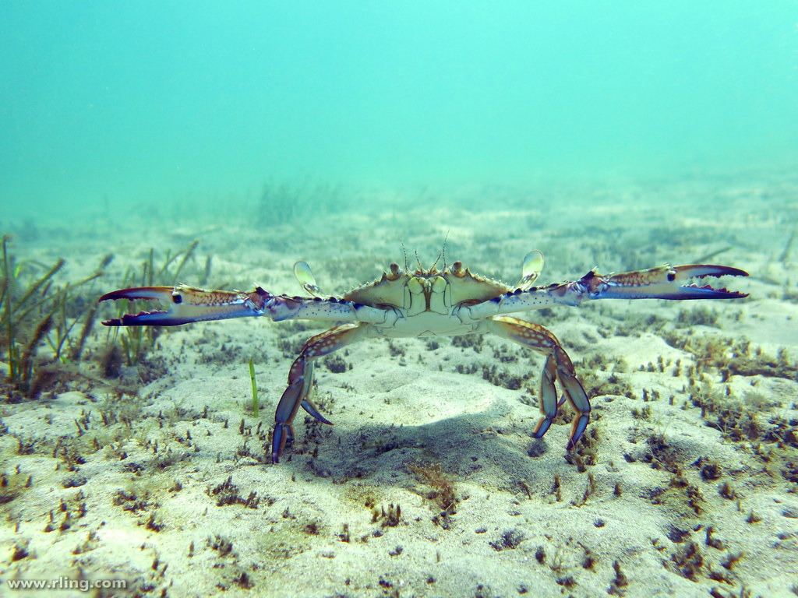
First - Create community
Please introduce yourself to the person right/left/in front of and/or behind you
Share with them your name (if you are comfortable with that)
Share with them your discipline (if you are comfortable with that)
Share with them your spirit animal (if you are comfortable with that)

Slide 3
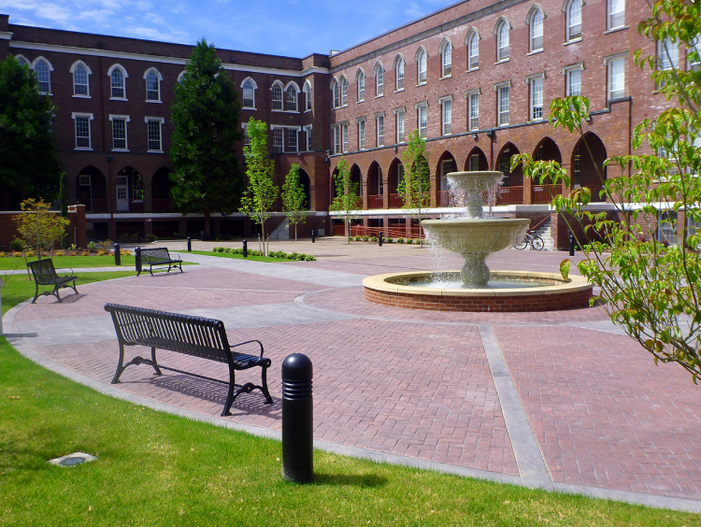
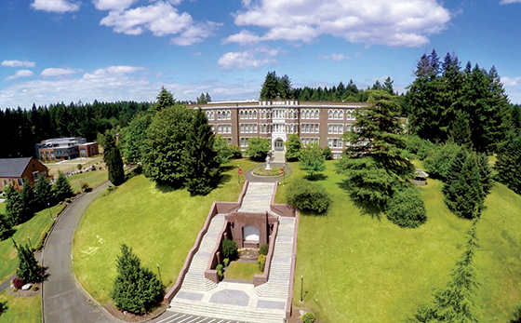
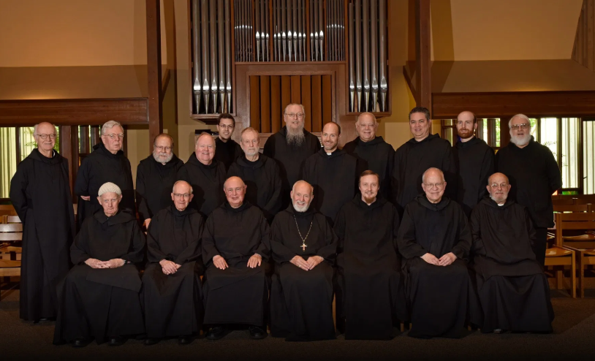

Slide 4
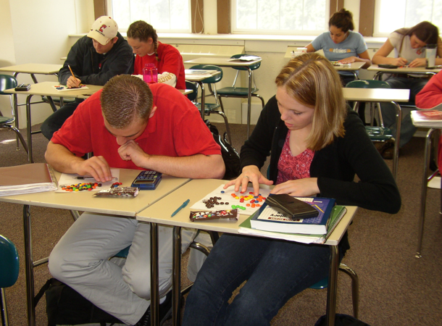
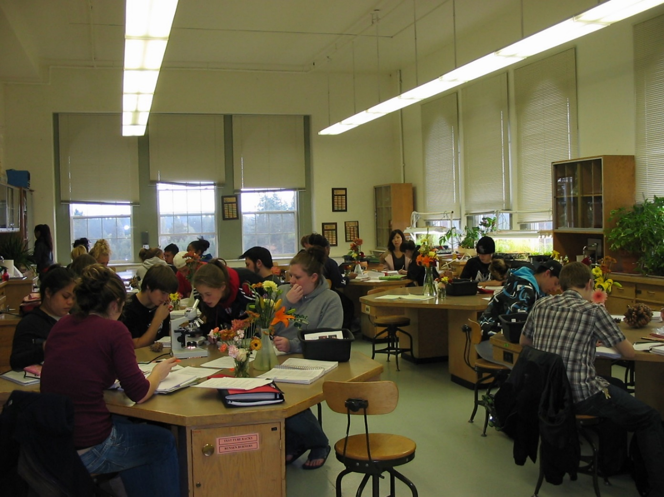
Our students

Slide 5
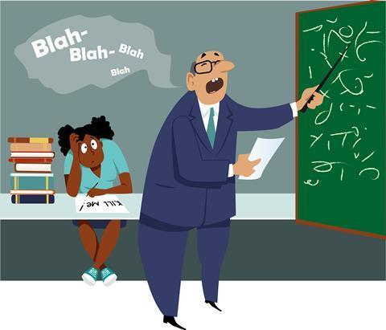
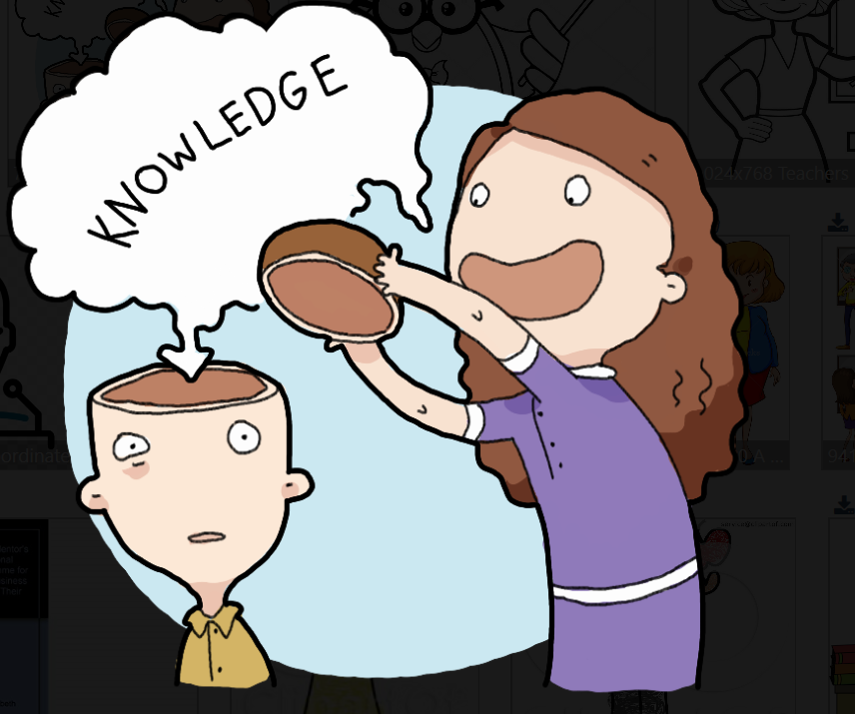
Bored teacher = bored students

Slide 6
Why change (or update)?
Selfishly – to keep myself excited about going into the classroom/lab
Based on previous students’ experience, what are the most difficult aspects of my course for students and/or when have students most struggled?
When have I/they been most unhappy with student/their performance?
If I could change my students’ study habits, what would I most like to change?
How can I get students to read the textbook?
In ten years, what do I want my students to remember most about my course?

Slide 7
Re-energize yourself and your course materials
Identify a topic that you’d like to try teaching in a different way
See if any of these ideas would be useful in your classroom
Tell your students you are trying something new

Slide 8
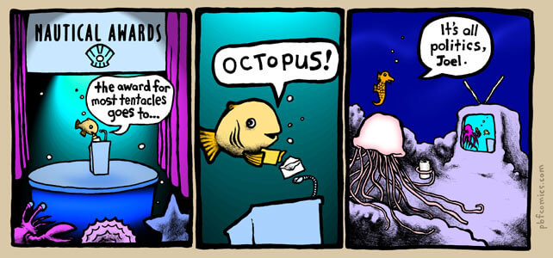
Humor
Pbfcomics.com
Gary Larson

Slide 9
Subtle changes to kick start my teaching & classroom
Redesign a class or lab activity
Use of goldfish crackers (pretzel and golden) for population genetics activity
Have students give short oral reports each Friday
Open notes exams or quizzes
Designing the “perfect parasite”
Choose a different textbook/add info from popular literature
Videos, podcasts, radio shorts
Play a card game of “Ecologies” in lab with general biology students
Review or have group quiz using “Jeopardy” game

Slide 10
Additions to the textbook

Slide 11
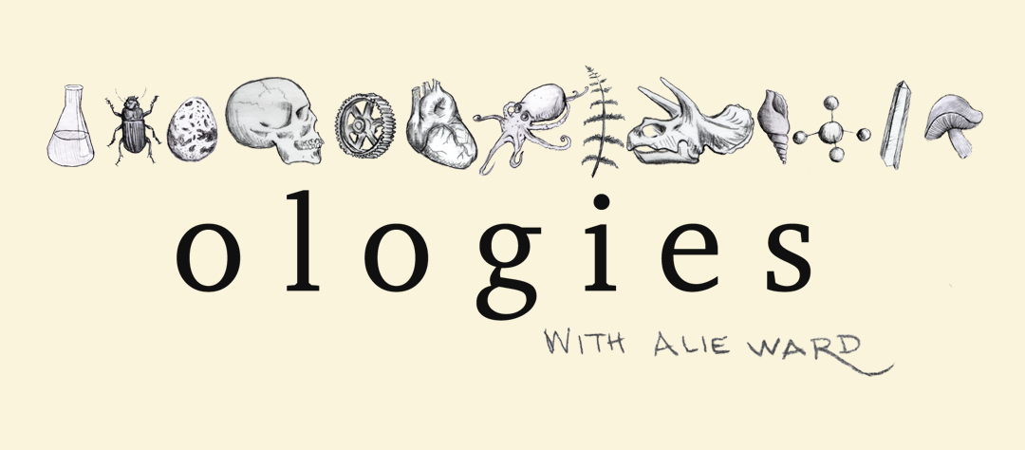
Podcasts
Ideas & Inspiration
Assignments

Slide 12
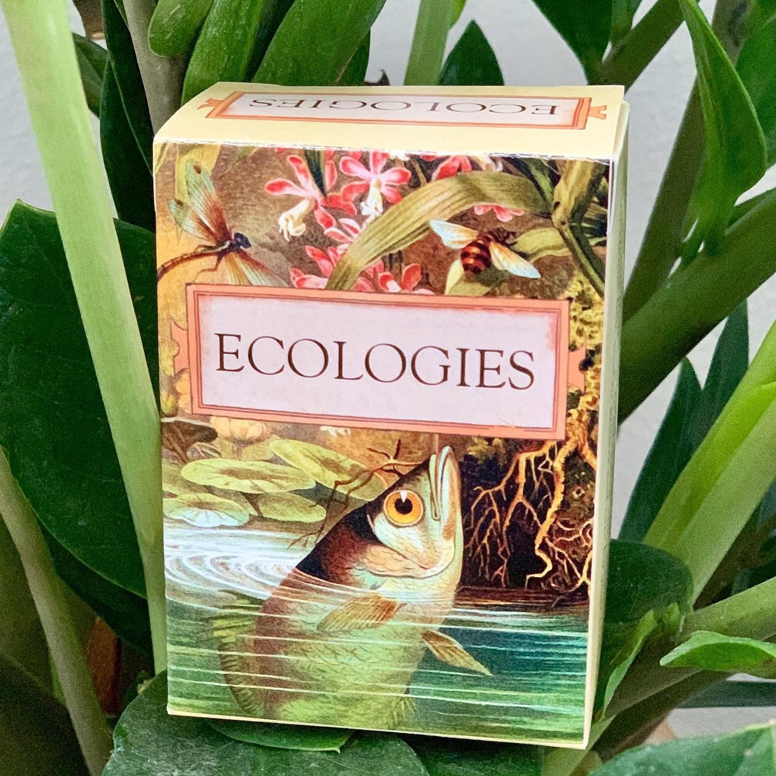
Ecologies – the card game

Slide 13
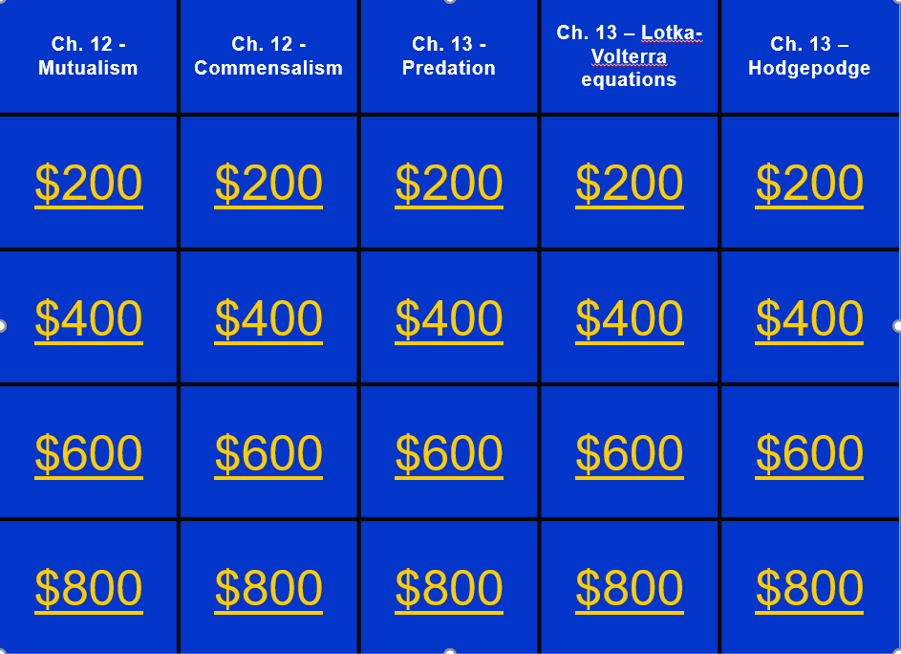
Jeopardy for review or quiz

Slide 14
Substantial changes in my teaching
Use more active learning strategies in the classroom
Team-teaching with a colleague from your own department (semester or a day)
Team-teaching with a colleague from a different department than your own (semester or a day)
Exchange day – trade a day teaching with another colleague
Have students teach a specific concept to each other or to the class
Design an entirely different course that addresses a topic that was lacking in your department’s curriculum
Offering a special topics course

Slide 15
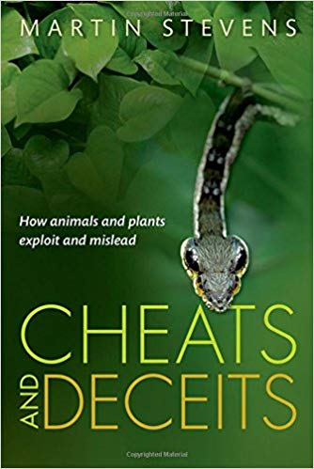
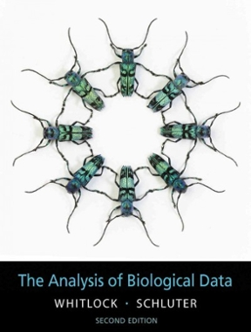
Design a new course!
Biostatistics
Cheats and Deceits

Slide 16
Writing in a biology classroom (students are no longer surprised)
Practice essay questions in class
In-class informal writing assignments (low stakes)
Have students write partial lab reports focusing only on one segment of the report
(introduction, methods, results, or discussion)
Writing a full lab report w/ all parts
Have students peer review lab reports
Critiquing a journal article
Write a “Dear Abby” letter or a Tinder ad as an invertebrate
Write an invertebrate haiku

Slide 17
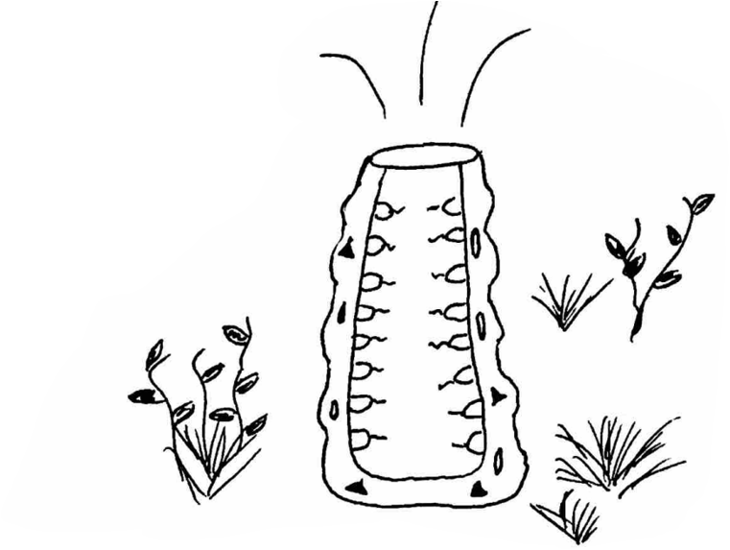
Haiku
Phylum Porifera
Porifera sponge
Choanocytes filter food
Marine snow foodie

Slide 18
Dear Abby letter written by a student

Slide 19
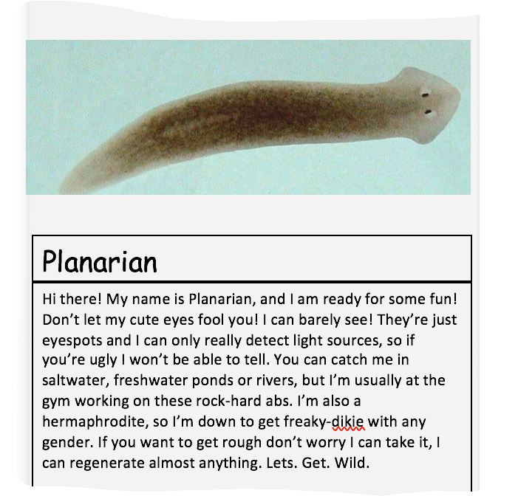
Tinder ad for invertebrates written by a student

Slide 20
Grading….the lab report
Shift from “editing-oriented” comments on papers to “revision-oriented” comments (Bean, 2011)
The importance of grading rubrics
RubiStar is a free tool to help teachers create quality rubrics.
http://rubistar.4teachers.org/index.php

Slide 21
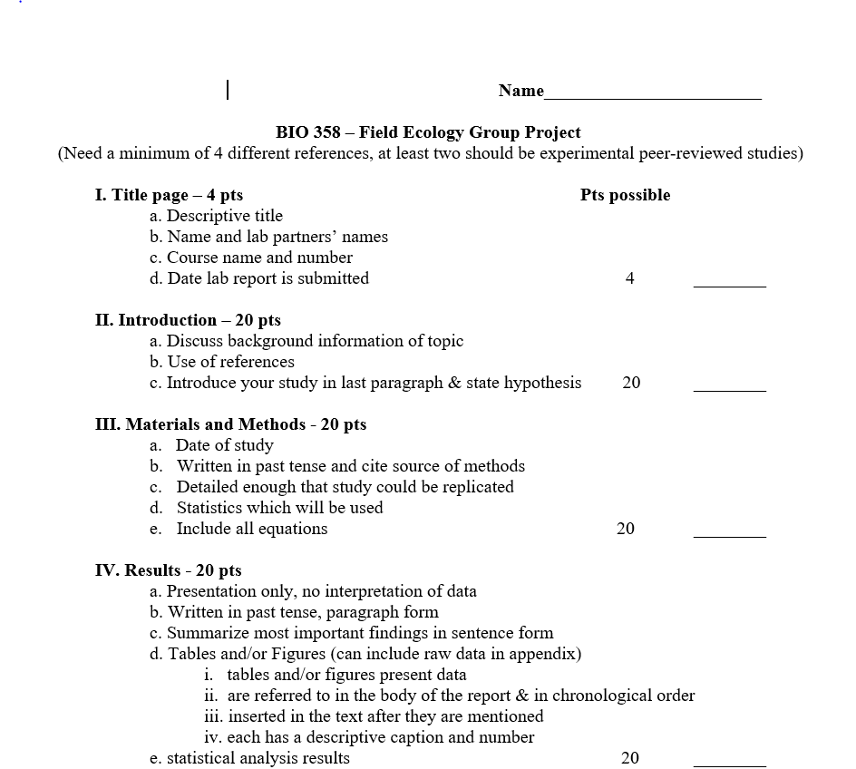
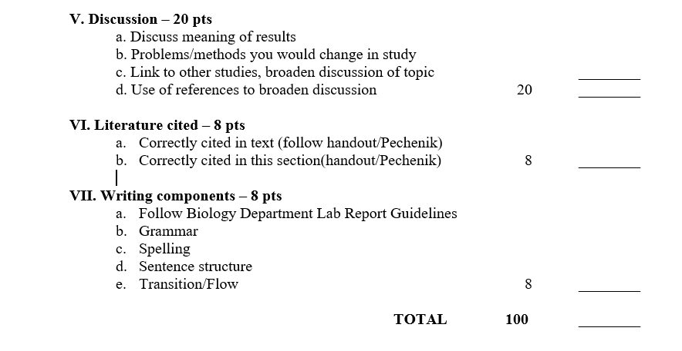

Slide 22
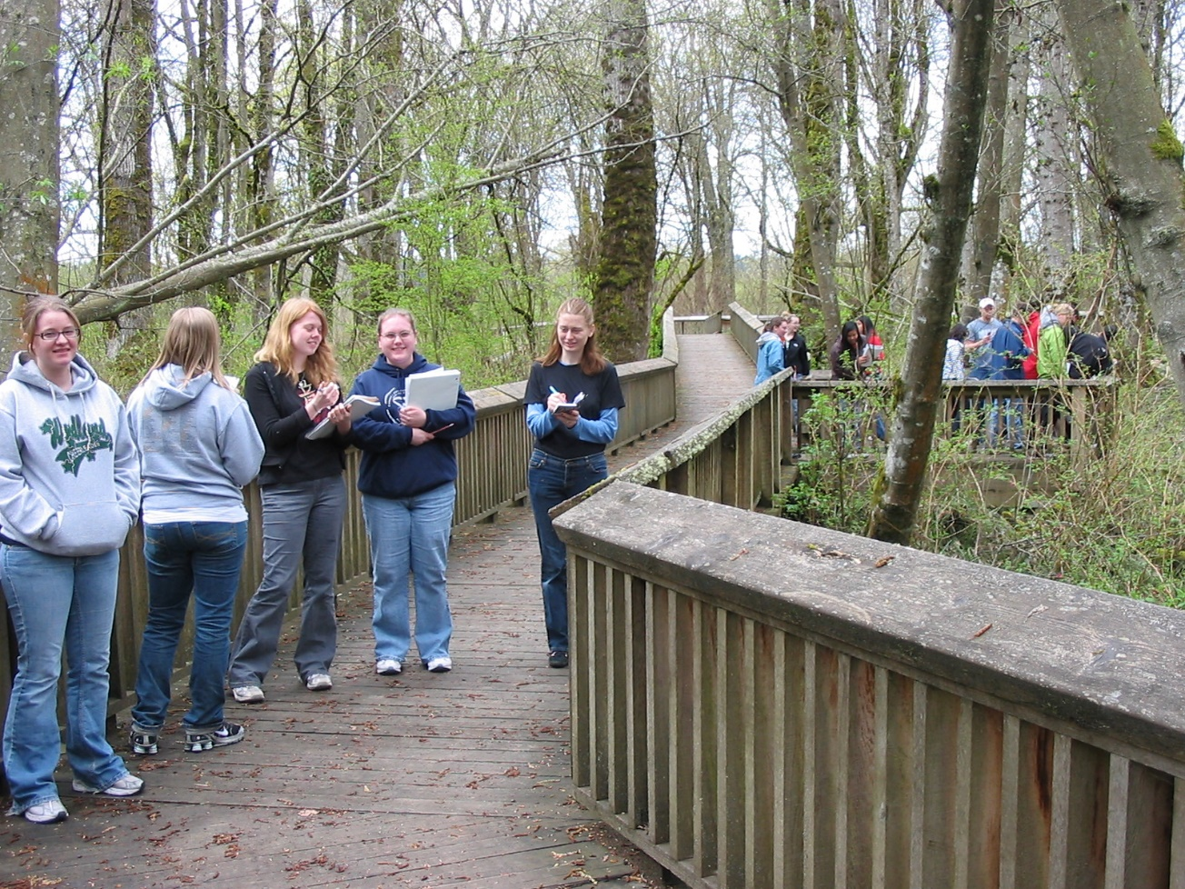
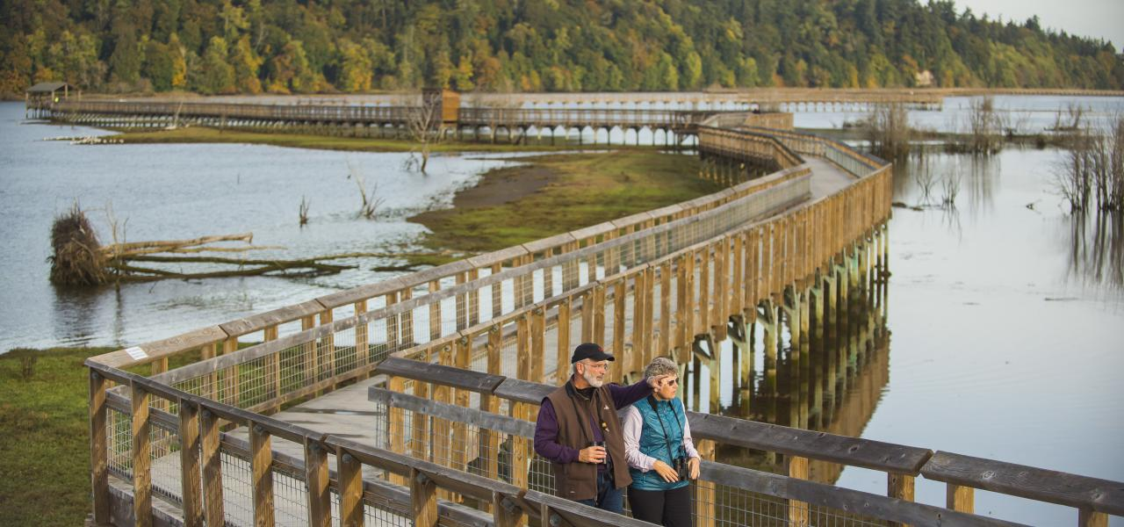
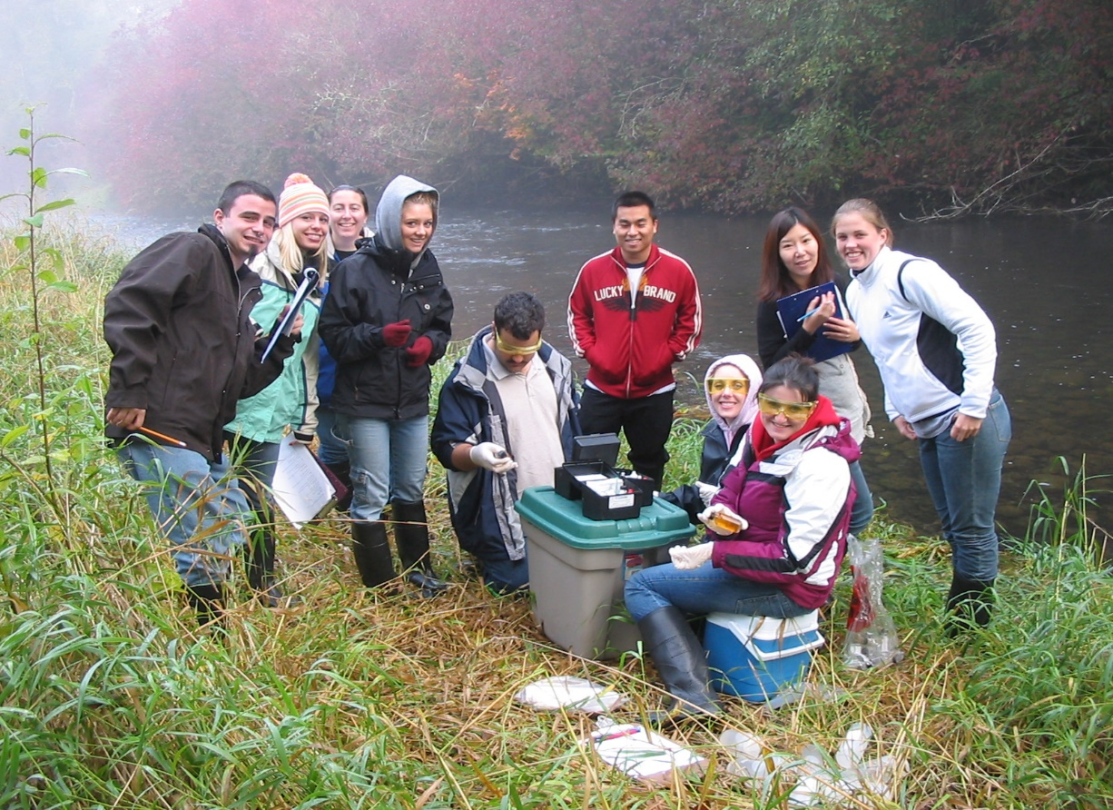
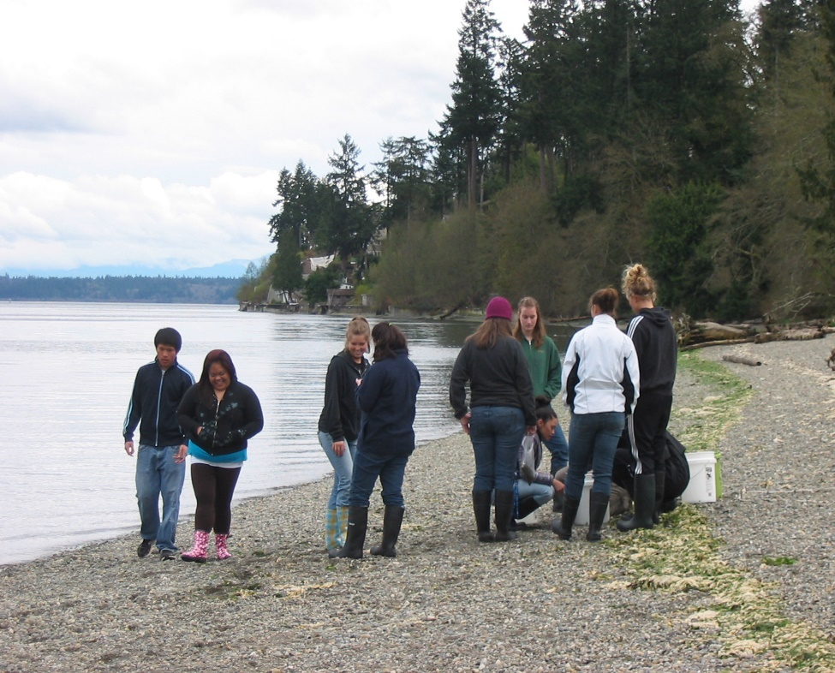
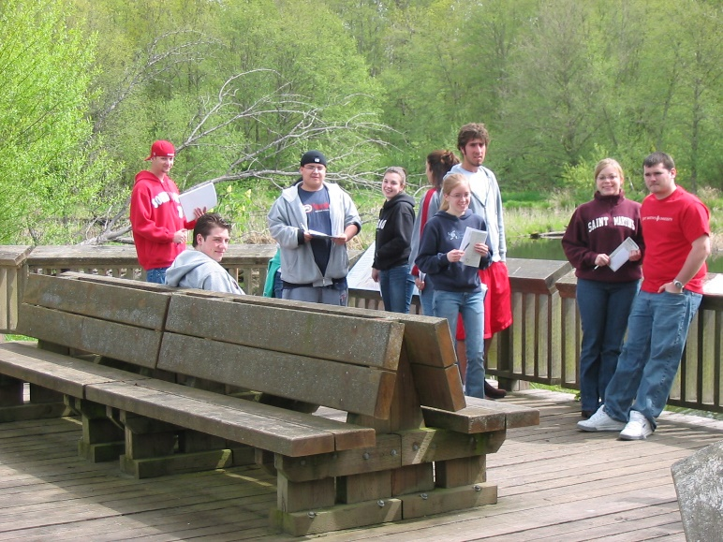
Field Trips

Slide 23
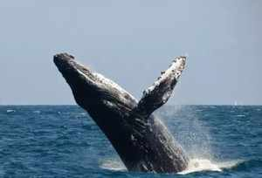
Teaching goals
Primary goal is teaching students
Help them develop a life-long interest in biology far beyond the classroom
Want to make a positive difference in my students’ lives
Help them to develop a deeper understanding and appreciation of the natural world, regardless of the career they pursue

Slide 24
Adapted from Confucius
When I just hear it, I forget.
When I hear and see it, I remember a little.
When I hear, see, and ask questions about it or discuss it with someone else, I begin to understand.
When I hear, see, discuss, and do it, it allows me to acquire knowledge and skill.
When I teach it to another, I start to master the topic.
Barkley (2010) and used with permission of John Wiley & Sons, Inc.

Slide 25
References
Baepler, P., Walker, J.D., Christopher Brooks, D., Saichaie, K., Petersen, C.I. 2016. A guide to teaching in the active learning classroom. Stylus Publishing, LLC. Sterling, Virginia.
Barkley, E. F. 2010. Student engagement techniques. A handbook for college faculty. Jossey-Bass, San Francisco, CA.
Bean, J.C. 2011. Engaging ideas. The professor’s guide to integrating writing, critical thinking, and active learning in the classroom. 2nd edition. Jossey-Bass, San Francisco, CA.
Quaye, S.J., Harper, S.R., Pendakur, S.L. 2020. Student engagement in higher education. Theoretical perspectives and practical approaches for diverse populations. 3rd edition. Routledge, Oxon, OX.

Slide 26
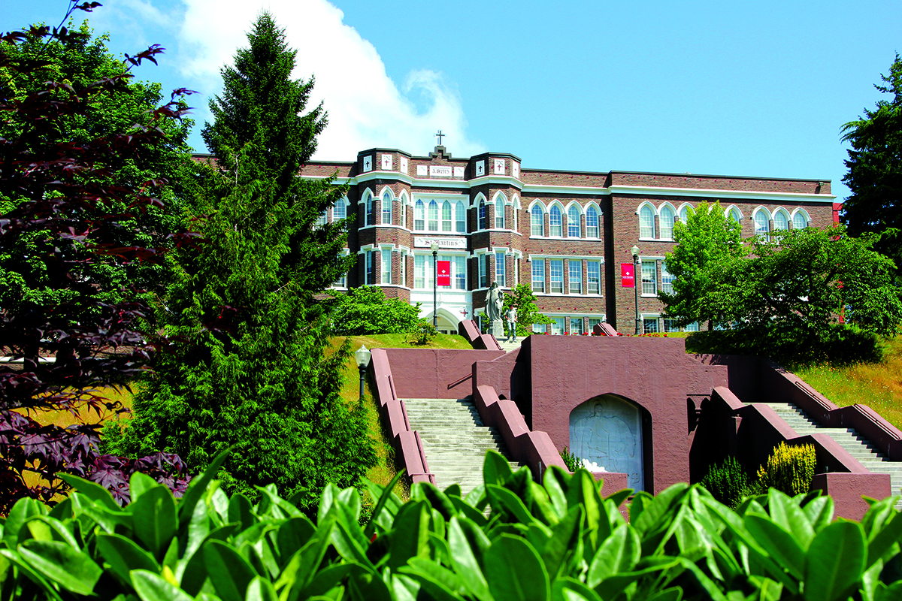
Lacey, WA
Thank you!
Mary Jo Hartman, Ph.D.
Associate professor of Biology
mhartman@stmartin.edu

