Slide 1
The Importance of Keeping Students Motivated and Engaged Efficiently
Nate Yerke, Anton Tolman & Genesis Gutierrez
Lilly San Diego, February 2020
Notes:
Find theme for presentation, low level TTM associated with high engagement, Maintenance also has high engagement. Clear Correlation between the 3, but they are measuring different things.

Slide 2
Metacognition & Resistance Team
Nate Yerke: Lead Investigator
Genesis Gutierrez: Assistant Investigator
Terrence Frazier: Lead Investigator
Anton Tolman, Mentor

Slide 3
Background on TTM and Metacognition
Flavell - Metacognitive knowledge... has to do with people as cognitive creatures and with their diverse cognitive tasks, goals, actions, and experiences.
Bransford, Brown & Cocking - Metacognition helps students become better learners.
Tolman, Johnson & Biggs - Found connections between TTM stages and use of effective learning strategies and deep approaches to learning.
Tolman & Kremling - Metacognition helps reduce student resistance to learning.
Notes:
Flavell, Father of Metacognition
Bransford etc, how people learn, general book about how the brain learns. Summarized alot of disparete literature

Slide 4
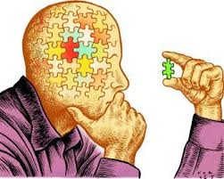
Pieces that Lead to Motivation
Student readiness to change how they learn (process metacognition) (TTM)
Engagement in the classroom (SCEQ)
Achievement emotions & motivation (AEQ)
Goal: Evaluate relationships between these scales, and determine if the TTM could replace the other two.
Notes:
TTM: willingness to change how they are learning (strategies)
SCEQ: what they do when in classroom
AEQ: Is about how they feel in the classroom

Slide 5
SCEQ & AEQ
SCEQ: Designed to assess various behaviors related to student engagement in the classroom, specifically, skills, emotions, participation, and performance
23 Questions, based on 5 subscales, relating to engagement
AEQ: Designed to assess various achievement emotions experienced by students in academic settings. Directly linked to the Control Value Theory (Pekrun, 2006)
Activating =causes change, ex: joy Deactivating= stops change, ex: Despair
24 Questions, Emotions are categorized as positive/negative, activating or deactivating, and separated by environment.
Notes:
Notes on CVT: Individuals experience these specific emotions when they feel in control of, or out of control of, achievement activities and outcomes that are subjectively important to them. This implies that control appraisals and value appraisals determine these emotions.
Other pieces are environment and learning+achievement, then there are also specifc treatments for each of these pieces.

Slide 6
Transtheoretical Model of Change (TTM)
Originally developed as a clinical theory for addiction (Prochaska & DiClemente) to identify those who succeed in treatment vs. not
Has been supported in health behaviors (e.g. exercise, weight loss), mental health treatment, even in organizational change
Recent research has begun to investigate the TTM in educational contexts (Tolman; Cole, Harris & Field; Moreira et al.) especially in relation to motivation, resistance, and academic performance
Had extremely high test-retest Reliability in recent research (98%!)
Often described as a “readiness to change” stage model

Slide 7
Transtheoretical Model (TTM) Stages

Slide 8
Brainstorm
How do you think metacognition affects student engagement and emotions?
How do you think these surveys would interact with each other? Would you expect these interactions to be significant?
Notes:
In study presented on Friday, recycling was shown in zoology class, Terrance’s research support a need to
Keep Brainstorming fairly short -- throw out ideas, find agreements? 3-4 minutes?
In past study, of college success course, compared TTMLS,and TTMGS LSSA, and SCEQ,
TTMLS had high correlation with SCEQ, linear progression between the two. Measured for GPA, SCEQ was highly correlated r=.25
Significant differences in GPA based on TTMLS score (based on TBL study DrT and DrWilson-Ashworth)
Students resistant to working in groups, (lower TTM scores across the board)

Slide 9
Purpose of Study
To further evaluate the TTM and how it relates to motivation and engagement
Research Questions:
What are the relationships between the TTM, SCEQ, and AEQ?
How do demographics affect scores on these tests?
What are the overall TTM, AEQ and SCEQ patterns seen in Intro Psych Courses at UVU?

Slide 10
Sample
Sample
263 Undergrad students in GE course
41% Male, 59% Female
37% First Generation
Ethnicity: 86% White, 14% Nonwhite
Class: 86% Fresh-Soph, 14% Juniors-Seniors
Schedule: 52% AM, 31% PM, 17% Online/Hybrid
Delivery: 82% Face to Face, 17% Online/Hybrid
Notes:
Schedule does not add up to 100%??

Slide 11
Samples of SCEQ
STUDENT ENGAGEMENT QUESTIONNAIRE
To what extent do the following behaviors, thoughts, and feelings describe you, in this course? Please rate each of the questions with a 1 through 5 based on the following scale, specifically related to how well it describes you.
4= extremely characteristic of me
3 = characteristic of me
2 = not really characteristic of me
1 = not at all characteristic of me
1. _____ Raising my hand in class
2. _____ Participating actively in small group discussions
3. _____ Asking questions when I don’t understand the instructor
4. _____ Doing all the homework problems
Notes:
Don’t go through all of this -- just very quick overview

Slide 12
TTM-LS Individual Study
S1. _____ I usually read assigned chapters before class, and I am making deliberate use of specific study or learning strategies when I study every week; I usually keep to my study schedule.
S2. _____ I have been thinking that it is time that I start taking more responsibility for my own learning and studying; I’m not learning as effectively or performing as well as I think I should.
S3. _____ Learning to study better is a good thing, but due to work, family or other things, I don’t have time or energy to study regularly; some instructors demand too much of busy students.
S4. _____ I have decided to find out about some new study strategies or skills that I can use this semester to improve my learning; I also have decided that I need to write out a specific study plan and am going to start following it soon.
S5. _____ Six months ago or more, I decided to really get serious and improve my study skills and learning strategies; I picked several new skills to learn and have been using them since then; I also worked out a study schedule and have stuck to it for at least a semester.
S6. _____ I believe it is the instructor’s job to teach me, not my job to teach myself; setting up a study schedule and learning new study skills is not worth the time it takes.
Notes:
Quick overview; maybe just pick one and reference it in terms of the stages you mentioned before

Slide 13
AEQ
To what extent do the following behaviors, thoughts, and feelings describe you, in this course? Please rate each of the questions with a 1 through 5 based on the following scale:
4 = Extremely characteristic of me
3 = characteristic of me
2 = not really characteristic of me
1 = not at all characteristic of me
Class-related emotions
1 I enjoy being in class ___
2 I am confident when I go to class ___
3 I am proud of myself in class ___
4 I am angry in class ___

Slide 14
Methods
Intro Psych students took a blended survey (48 questions total) of all three instruments.
Survey was administered through Qualtrics in the last 4 weeks of class
Demographic questions were listed at the end of the surveys
TTM was collapsed into 5 categories to maintain stability in statistical analyses (few students in MN)
Notes:
Do you think the last 4 weeks of class could have influenced the results?????

Slide 15
Results
RELIABILITIES
AEQ Positive Emotions: ɑ = .783
AEQ Negative Emotions: ɑ = .857
SCEQ ɑ = .86
Inferential Tests
There was significant differences in both positive and negative feelings based on gender, with F having more positive feelings and less negative then M
Underclassmen had more positive feelings then Upperclassmen
Humanities had far more positive feelings then any other major
There was a significant relationships between all three tools.
.000 between SCEQ and TTM, - Anova
-.51 between SCEQ and AEQ Pos -Correlations
.40 between SCEQ and AEQ Neg
Notes:
Reliability, Demographics,Anova’s and T-tests (Delete, old analysis, only keep current ones)
T test: significant result t(df)=__,p<.05
Mean1, Mean 2
Anova: significant result f(df)= __, p<.05

Slide 16
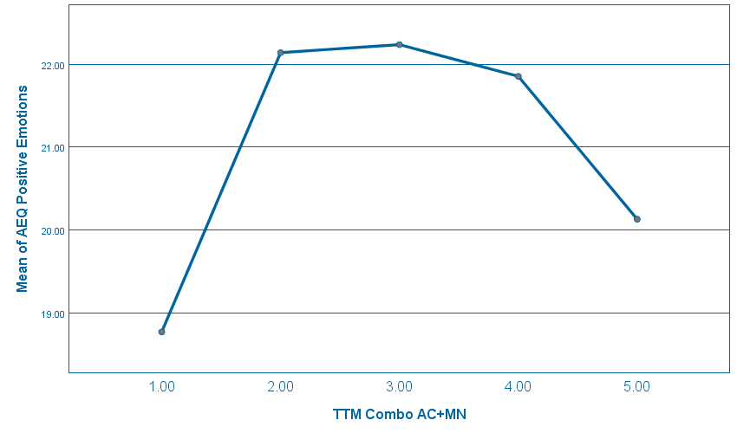
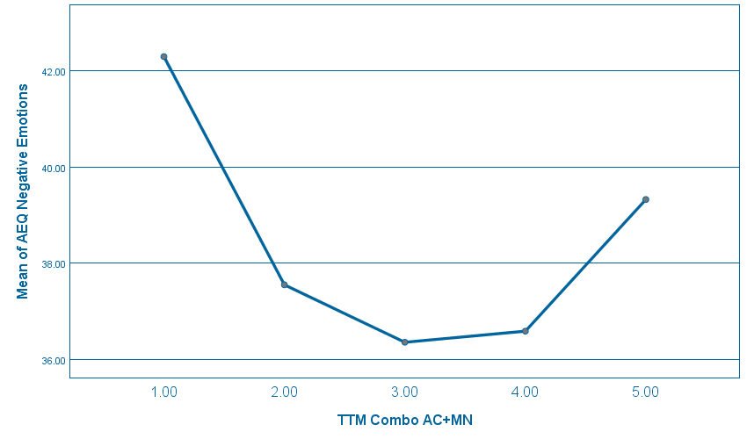
TTM & AEQ Relationship
TTM Compared to the AEQ Positive TTM Compared to the AEQ Negative

Slide 17
Think-Pair-Share
Do you think these instruments could be useful to help you better understand your students?
How can you overcome obstacles to their use in your class?
Notes:
2-3 minutes to write, 8 minutes to Pair, 4-5 minutes to share; TOTAL = 15
START THIS SLIDE AROUND 22-23 minutes (Put major discussion here)

Slide 18
Implications
All three of the tools are valid, but they measure different constructs
Motivation is a complex, multi-faceted construct
There were some relationships between the surveys, but lower than expected
Our tentative explanation is that students using surface levels of learning have more negative emotions toward learning. As they start to use deeper levels of learning, they level out before eventually understanding they need some anxiety to push themselves to succeed in deeper learning; alternative: maybe MN students were concerned w/graduating?
Future research will involve administering this survey to upper division classes in different fields to compare how these constructs interact in new settings
Notes:
Survival mechanism, falls back, Dr. T Instruments were highly correlated to deep approach to learning
Mention Terrence’s study? Each class is different, and maybe GE is distinctive as well?
What about the SCEQ results? How do they compare to the earlier study?

Slide 19
Q&A about study

Slide 20
3-2-1 to promote Metacognition
Use the 3-2-1 Method to promote your own metacognition:
3- Things you learned in the session
2- Thoughts about what you can apply in your classroom
1- Question you still have about the subject
Notes:
42 Minutes at this slide

