Slide 1
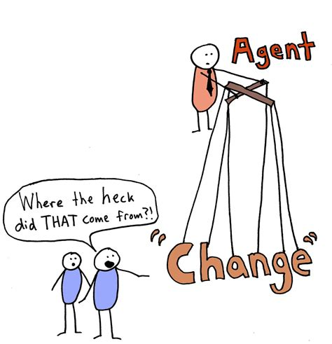
Be the Change Agent
Self-Care and Removing Inner Obstacles
Sandy Guzman Foster, Ph.D. & Sherry Herbers, Ed.D.
University of the Incarnate Word

Slide 2
This Photo by Unknown Author is licensed under CC BY-NC-ND

Slide 3
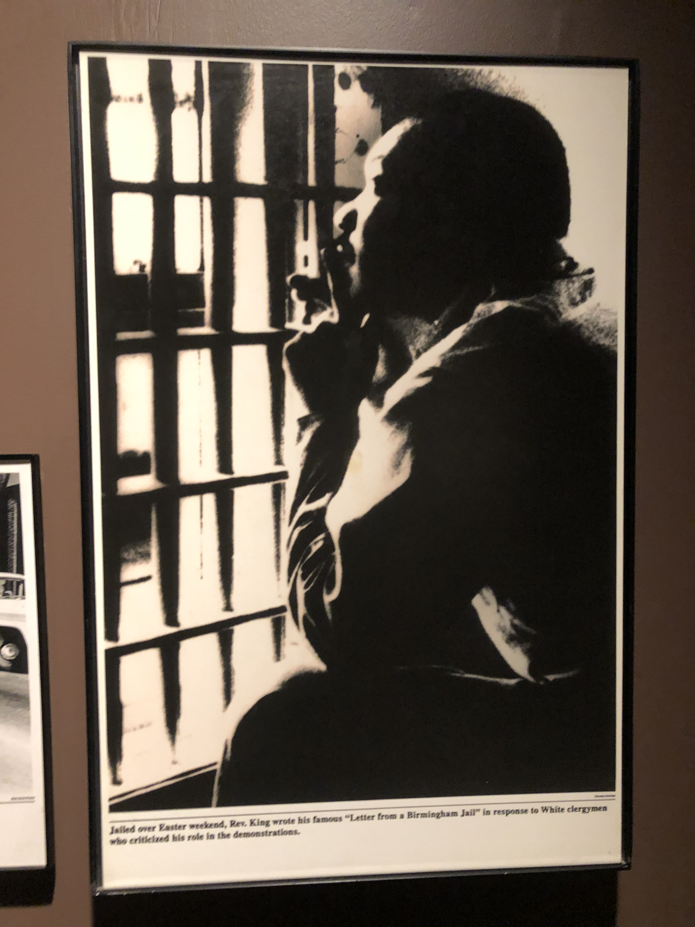
Emotional Work

Slide 4
What are barriers to self-care and compassion for self?

Slide 5
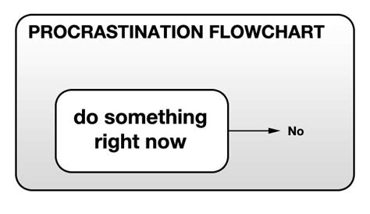
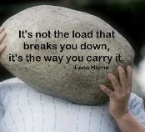
Known Barriers

Slide 6
Our patterns

Slide 7
Beholding

Slide 8
Self Compassion

Slide 9
What will you do during this conference to care for self?
What will you do be compassionate to self?

Slide 10
Resources
https://sites.google.com/view/fosterselfcare/home

Slide 11
Contact Information
Sandy Guzman Foster, Ph.D.
sfoster@uiwtx.edu
Sherry Herbers, Ed.D.
herbers@uiwtx.edu

