Slide 1
Digital Discourse: 21st Century Tools to Venture beyond Highlighters and Post-Its!
Dale Vidmar Information Literacy and Assessment Librarian Southern Oregon University Hannon Library vidmar@sou.edu Teaching for Active and Engaged Learning Lilly Conference 2020 San Diego, California February 28, 2020 http://bit.ly/lilly2020-vidmar
Notes:
To change the image on this slide, select the picture and delete it. Then click the Pictures icon in the placeholder to insert your own image.

Slide 2
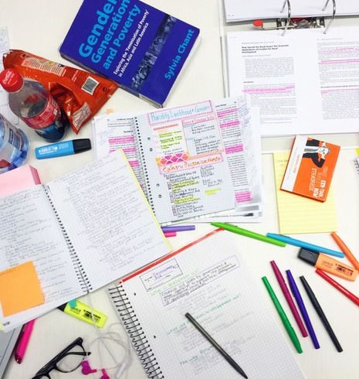
What are We Doing and How?
What? The Takeaways or What We Can Do on Monday!
Adapt and incorporate emerging digital tools into instruction and interaction with texts to assist students with research, writing, and information management.
Demonstrate various digital tools and transform the way students interact with information.
Illustrate alternative emerging methods to read, highlight, annotate, tag, and organize research in order to improve student learning.
How? What You will be Subjected To!
Presentation of a variety of digital tools organized in categories.
Demonstration of select tools.
Question and Answer/Comments.

Slide 3
Digital Discourse
Padlet
Go to: padlet.com/vidmar/lilly2020
password: digital

Slide 4
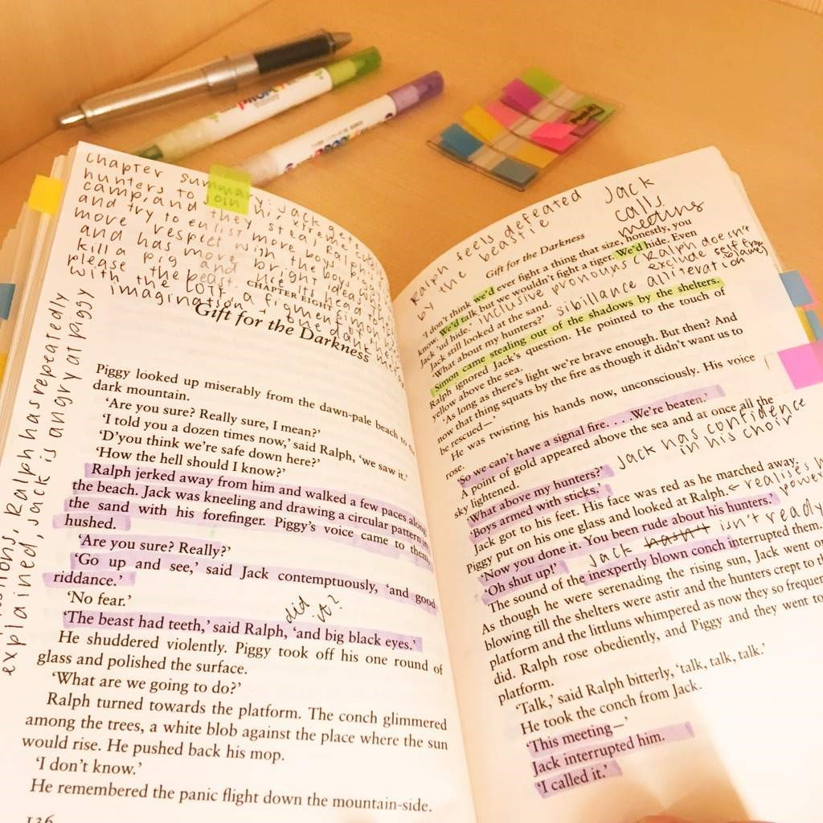
Marginalia/Digital Annotation
Marginalia (Jackson, 2001)
Writing in the margins or another area of other people’s text.
Thought of as discourse or reader response.
Spontaneous notes or comments (McClelland, 2016).
Measure of intellectual engagement of reader.
Digital Annotation
Also called “digital social reading” and “digital discourse” (Skains, 2019).
Using digital methods for annotations, comments, and notes.
Online means of interacting with text.
Includes but is not limited to annotations, notetaking, tagging, voice-to-text, brainstorming, grammar and spell checkers, citation generators, information management and organization, image editors, etc.

Slide 5
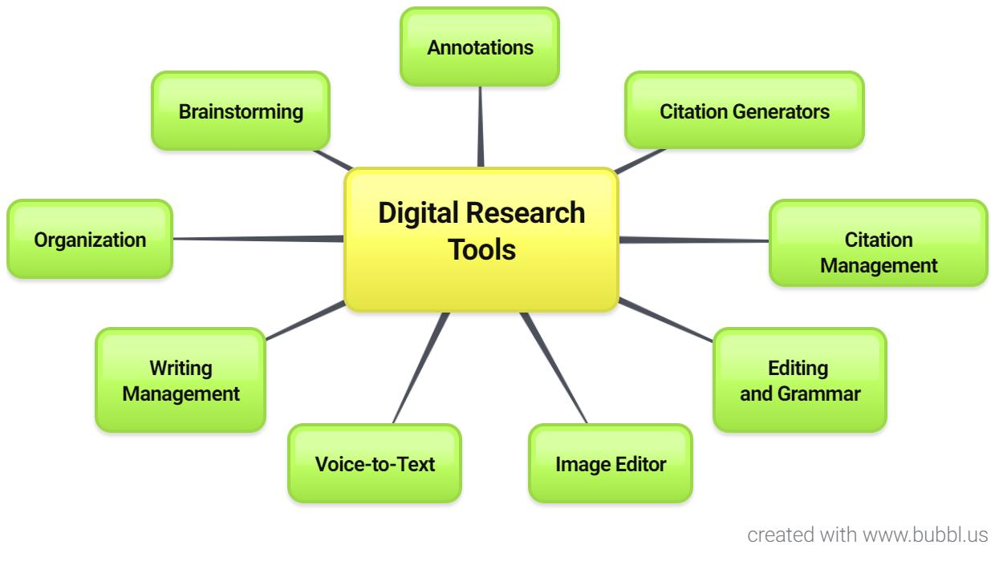
Digital Research Tools

Slide 6
Most paper annotations are relatively simple "anchor only" type annotations consisting of underlining, circling, margin notes, etc. (Mehta, Bradley, Hanncock, & Collins, 2017).

Slide 7
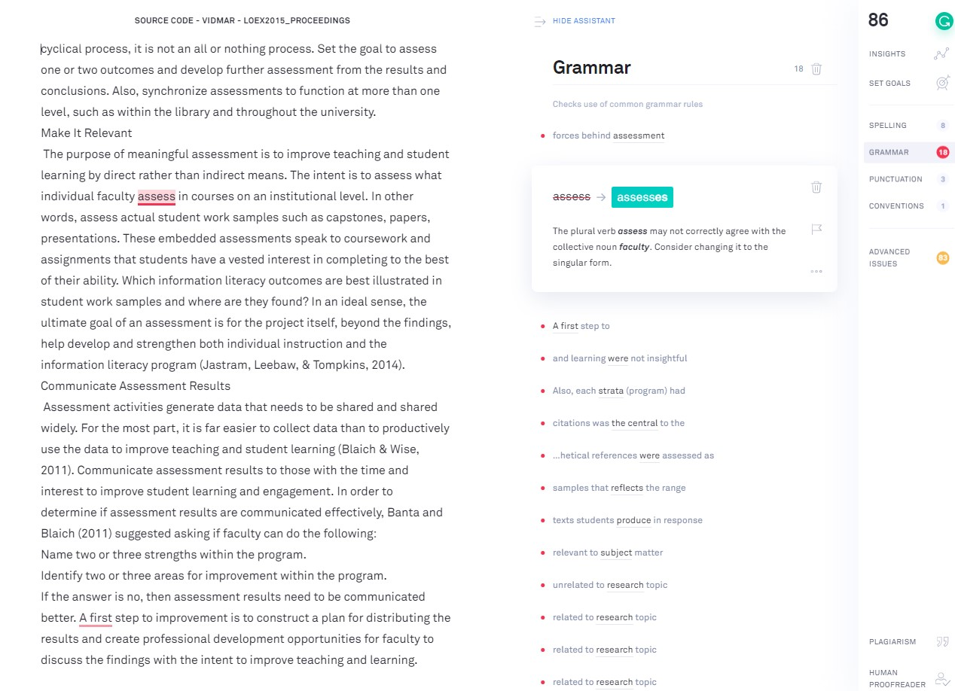
Grammar and Editing
Minimum Basic Requirement
Grammarly - www.grammarly.com – check grammar, writing style, spelling and other aspects of writing including plagiarism. Works with cell phone.
Ginger - https://www.gingersoftware.com/ - proofreads and checks punctuation and Grammar inside Word, so you do not have to upload or copy and paste text.
Hemingway App - http://www.hemingwayapp.com/ – highlights lengthy, complex sentences and common errors to help write more concise and clear sentences. Paste text into the app or write something directly.

Slide 8
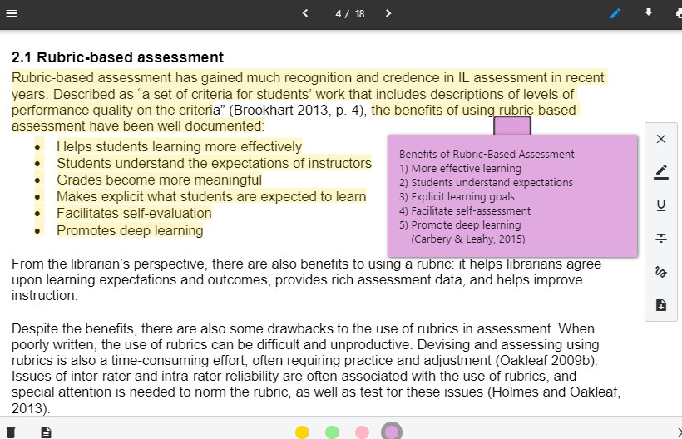
Basic Digital Tool Features
Underlining/Highlighting
Notetaking/Writing in the Margin
Organizing Ideas and Concepts
Tagging
Searching
Citation Management
Voice-to-Text

Slide 9
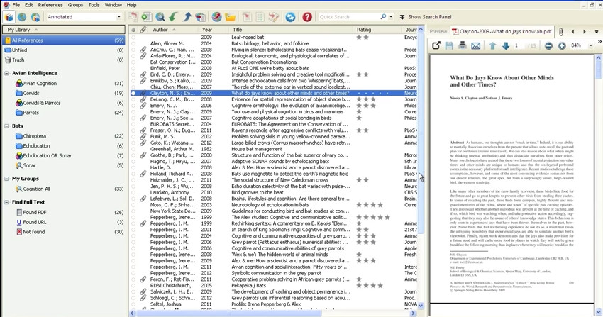
Top of the Class
Endnote - endnote.com/ - commercial online research and reference management tool that stores, searches, and constructs bibliographies a myriad of style beyond APA, MLA, etc. Endnote also annotates, tags, and searches documents and notes. Also, works with word processing software such as Word to insert citations and create bibliographies and in text citations.
RefWorks - www.refworks.com/refworks2 - powerful commercial online research and reference management tool that stores information, generates citations, and creates bibliographies in a myriad of formats beyond APA and MLA. Similar to Endnote, Refworks annotates, tags, and searches documents. The Write-n-Cite feature works with word processing software such as Word to insert citations and create bibliographies and in text citations.

Slide 10
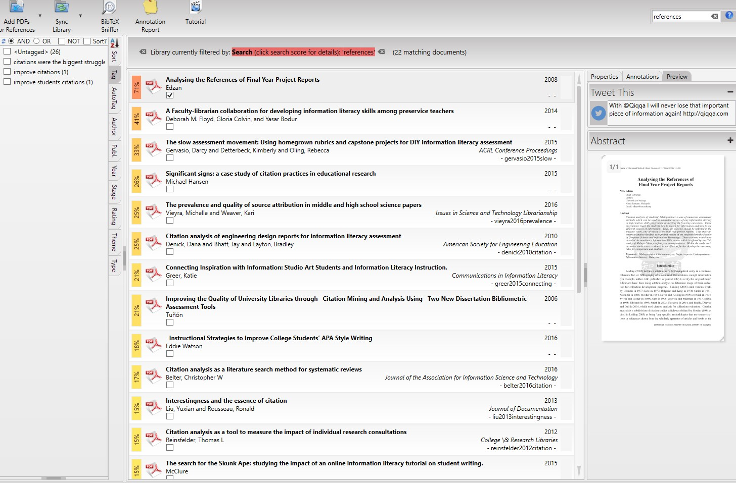
Citation Management
Qiqqa - www.qiqqa.com/ - manage references, read, annotate, tag, search, and cite .pdfs and other documents.
Mendeley - www.mendeley.com/ - create a personal library of research. Search, sort, annotate, create sticky notes, and cite using appropriate style.
Citavi - https://www.citavi.com/en - manage references, integrate .pdfs and other documents, evaluate content, organize content, and cite sources. Limited use free version.
JabRef - http://www.jabref.org/ - manage references and store fulltext documents online. Export files from databases such as PubMed, Google Scholar, Web of Science, Medline, or with the Digital Object Identifier (DOI).

Slide 11
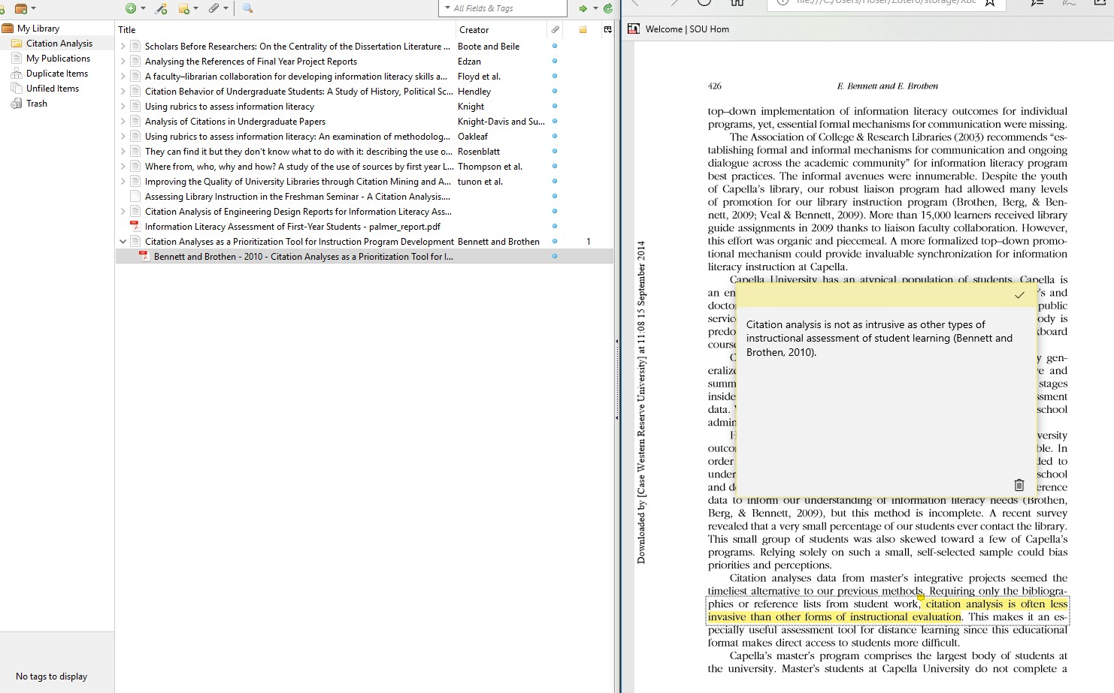
Citation Management
Zotero - www.zotero.org – tools that creates a searchable personal library of sources, indexes the full-text, annotates, tags, and cites references. Limited 30 MB free storage.
ReadCube - www.readcube.com – tool that imports .pdf files, manages searchable references, makes inline notes, compiles notes, and highlights while reading. Cost - $55/year.

Slide 12
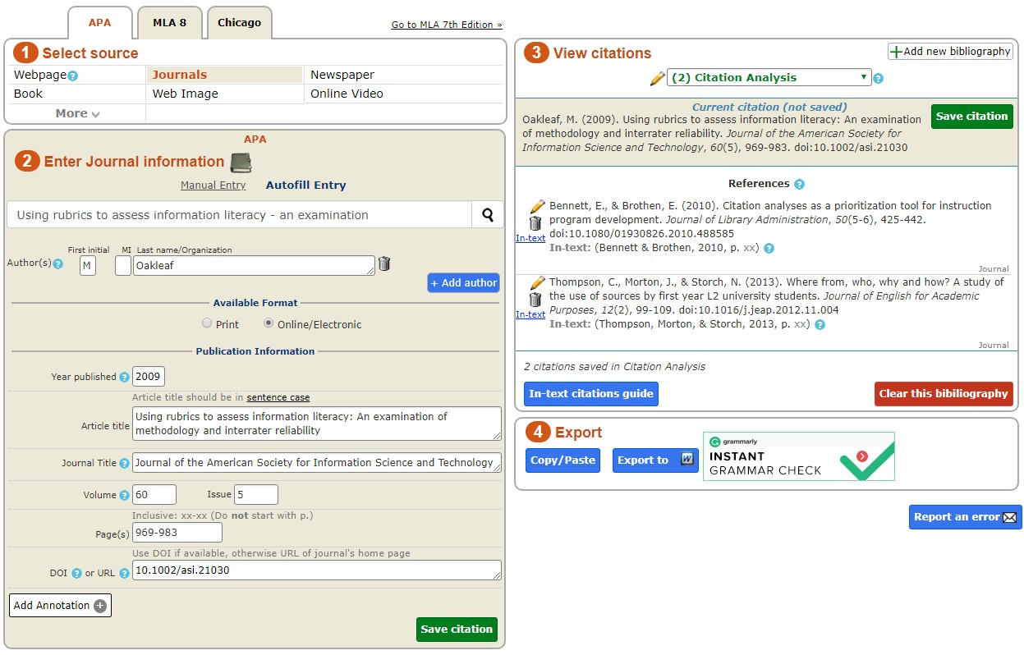
Citation Generators
Citefast - http://www.citefast.com/ - generates bibliography, in-text citations, and a title page in MLA, APA, and Chicago. Citations kept indefinitely with free account. Provides in-text examples.
BibMe - www.bibme.org/ - creates citation lists in MLA, APA, Chicago, and Turabian. Also, checks paper for grammar, sentence structure, style, and unintentional plagiarism.
Citation Machine - http://www.citationmachine.net/ - generates citations in MLA, APA, Chicago, Turabian, and more.
Easy Bib - http://www.easybib.com/ - generates citations and works cited pages in MLA, APA, and Chicago formats. Includes citation guides for the various formats.

Slide 13
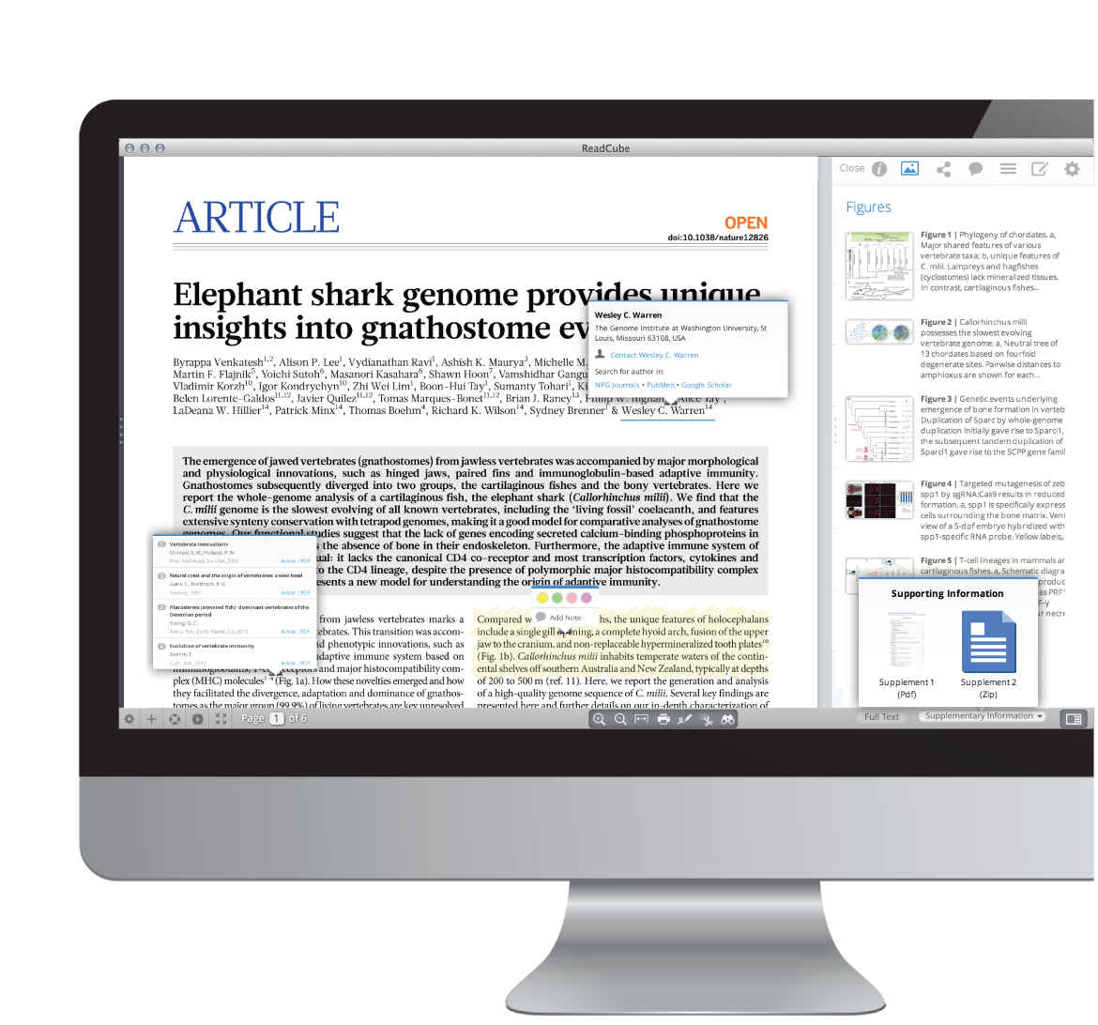
Annotation
A.nnotate - a.nnotate.com/ - store and share comments on .pdf files, Microsoft Office documents, images, and Internet sites. Includes the ability to create notes anywhere on an item and share them with others. Works on common browsers without having to install software or plugins. Limited documents space with free subscription.
ReadCube Papers - www.papersapp.com/– tool that imports .pdf files, manages searchable references, makes inline notes, compiles notes, and highlights while reading. Cost - $5/month.
Scribe - http://chnm.gmu.edu/tools/scribe/ - program for note-taking program that can manage research notes, comments , and ideas, so they can be indexed, searched, and cross reference like an online index card that is searchable.

Slide 14
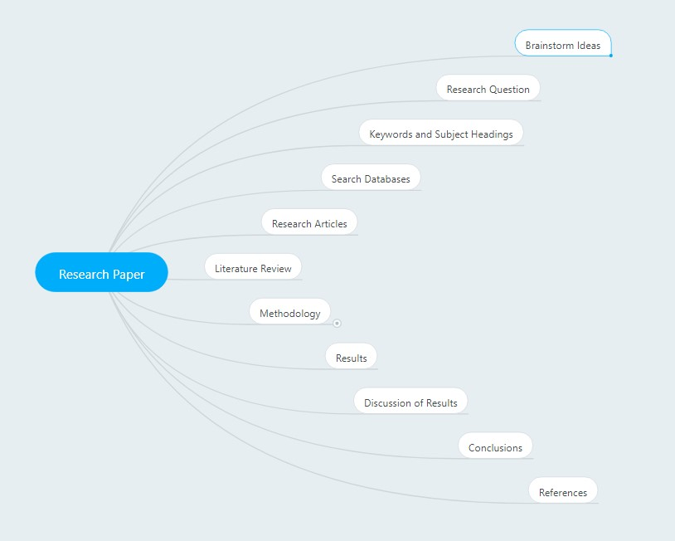
Brainstorming
Mindmeister - www.mindmeister.com – collaborative mind mapping and brainstorming tool to help organize your thoughts. Up to 3 free mind maps or $4.99/month for unlimited mind maps.
Bubbl.us - https://bubbl.us/ – visual thinking tool that creates a graphical mind map of ideas and concepts to structure information. Up to 3 free mind maps or $59 annually--$4.91/month for unlimited mind maps.
MindMup - www.mindmup.com/ - brainstorm and create mind maps, presentations, and outlines to help focus ideas and collaborate with others. Converts mind maps to .pdf, PowerPoint, and other programs. Unlimited free mind maps.
VUE - vue.tufts.edu/ - visual understanding environment (VUE) provides a concept and content map to visually organize digital files. Download app for free Windows or Mac versions.

Slide 15
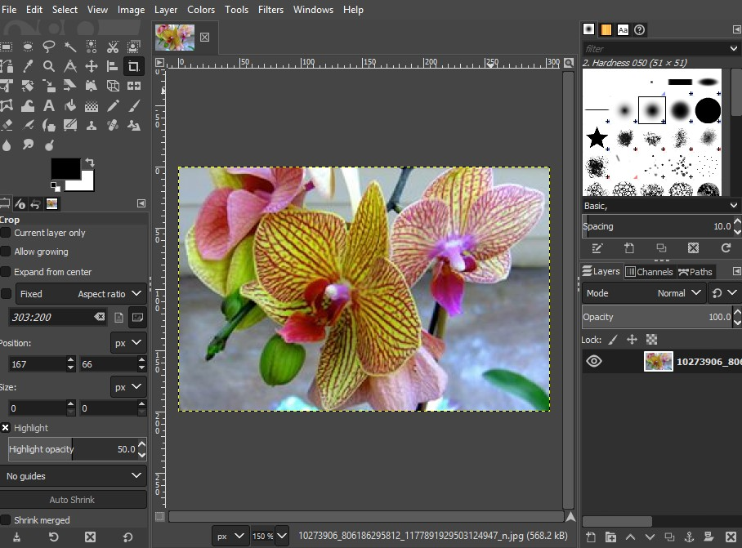
Image Editor
GIMP - www.gimp.org – open source image editor that enable retouching, resizing, rendering, and converting format.
Photo Pos Pro - https://www.photopos.com/ - offers separate alternative interfaces for novice or advanced users. Enables image editing and correction tools. Limited size of saved files.
Pixlr Editor - https://pixlr.com/editor/ - open source free Photoshop style photo/image editor.
SumoPaint - www.sumopaint.com – photo/image editor that works directly from the browser without installing software.

Slide 16
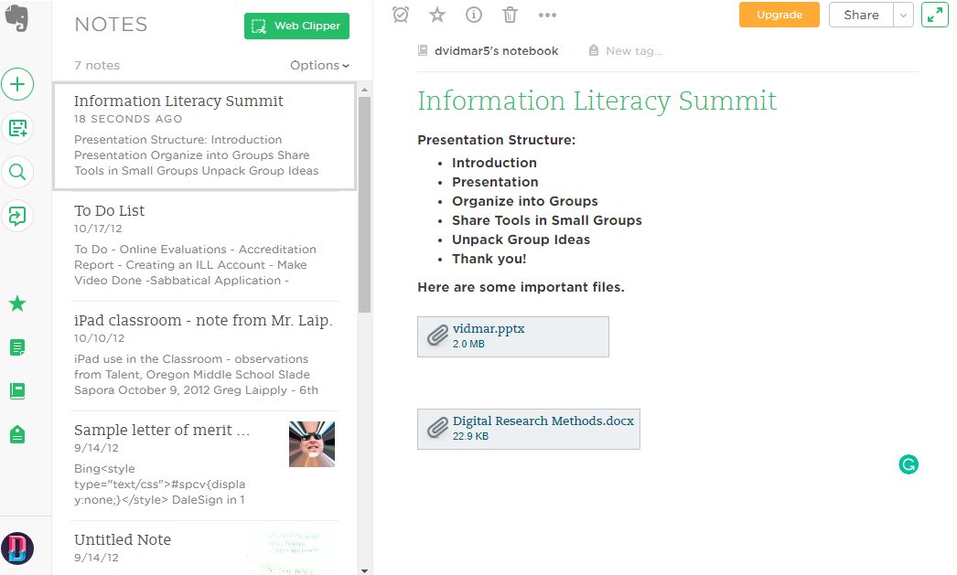
Organization and Collaboration
Padlet - padlet.com – create a “virtual whiteboard” a “virtual wall” which allows immediate and collaborative responses individually or in groups of any size.
Evernote - evernote.com/ - create texts, photos, and audio notes. Free subscription synchronizes notes on two different devices.
WorkFlowy - workflowy.com – organizational tool to create lists, take notes, and write collaboratively.

Slide 17
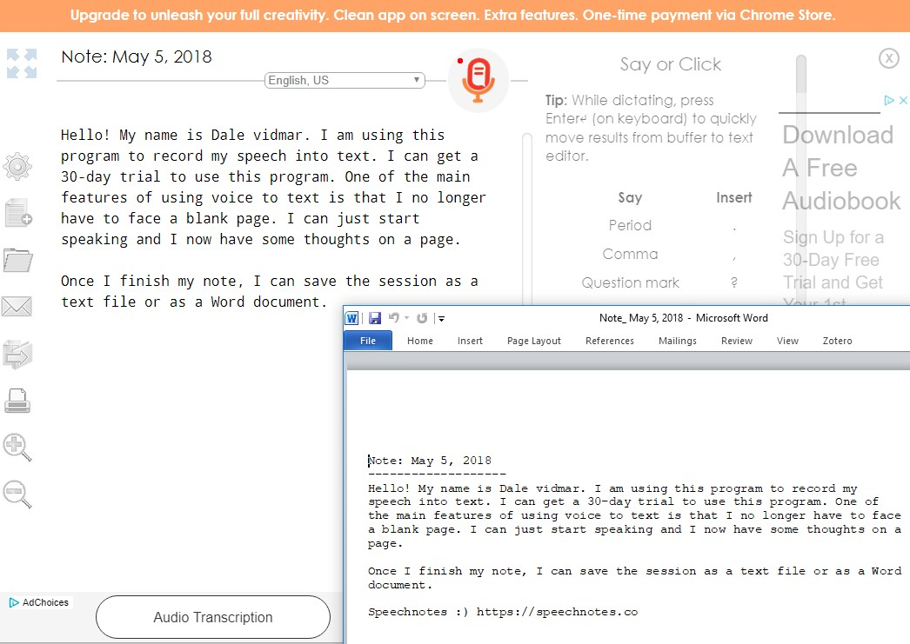
Voice-to-Text
Speechnotes - https:/speechnotes.co/ - free, easy to use voice-to-text enabled online notepad that works entirely in Google Chrome. Save notes in Word.
Dragon Naturally Speaking - www.nuance.com/dragon - speech recognition software that formats voice into text.
TalkTyper – https://talktyper.com – basic voice-to-text dictation tool that captures speech and creates plain text that can be copied and pasted elsewhere.
VoiceNote - https://voicenote.in/live/ - downloadable voice recognition extension that converts speech to text.

Slide 18
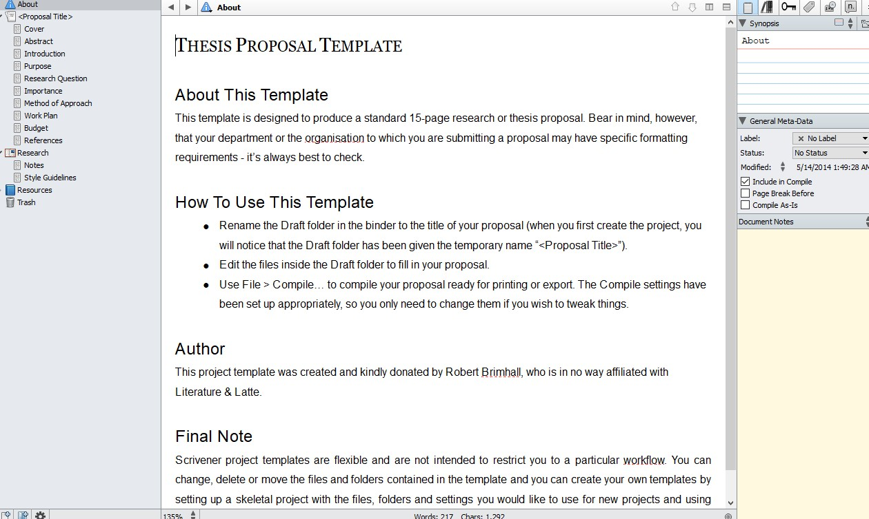
Writing Management
Scrivener - www.literatureandlatte.com/scrivener/overview – compose and structure long documents. Easily write, structure, and revise. Educational license for $38.25.
Write! - https://writeapp.co/– distraction free text editor that automatically cloud saves and has a variety of features such as set daily goals, auto-complete, unlimited undo, spell checker, and productivity counters, and a dark/light mode that focus the light on the current paragraph. Cost is $24 or $9.95 for students.

Slide 19
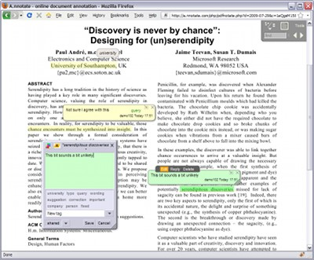
Conditions for Successful Implementation of Digital Research Tools
Three necessary considerations for implementing electronic texts and digital technology:
Students must be instructed in available technologies.
Students and faculty should be encouraged to share expertise and strategies for using digital tools and electronic texts.
Professional development is essential to successful integration. (Ross, Pechenkina, Aeshliman, and Chase, 2017).

Slide 20
References
Blyth, C. (2014). Exploring The Affordances Of Digital Social Reading For L2 Literacy: The Case Of Ecomma. In J. P. Guikema and L. Williams (Eds.), Digital literacies in foreign and second language education, 9, 201-226.
Bold, M. R., & Wagstaff, K. L. (2017). Marginalia in the digital age: Are digital reading devices meeting the needs of today's readers? Library & Information Science Research, 39(1), 16-22. doi:https://doi.org/10.1016/j.lisr.2017.01.004
Jackson, H. J. (2001). Marginalia: Readers writing in books. Retrieved from https://ebookcentral.proquest.com
McClelland, S. I. (2016). Speaking back from the margins: Participant marginalia in survey and interview research. Qualitative Psychology, 3(2), 159-165. doi:http://dx.doi.org/10.1037/qup0000061

Slide 21
References
Muddiman, E., Lyttleton-Smith, J., & Moles, K. (2019). Pushing back the margins: Power, identity and marginalia in survey research with young people. International Journal of Social Research Methodology, 22(3), 293-308. doi:http://dx.doi.org/10.1080/13645579.2018.1547870
Ross, B., Pechenkina, E., Aeschliman, C., & Chase, A. M. (2017). Print versus digital texts: Understanding the experimental research and challenging the dichotomies. Research in Learning Technology, 25, 1-12.
Skains, R. L. (2019). Discourse or gimmick? Digital marginalia in online scholarship. Convergence: The International Journal of Research into New Media Technologies, x(xx), 1-14. doi:https://doi.org/10.1177/1354856519831988
Solas, E., & Sutton, F. (2018). Incorporating digital technology in the general education classroom. Research in Social Sciences and Technology, 3(1), 1-15.

Slide 22
What are you doing? and What tools are you using?
Notes:
To change the image on this slide, select the picture and delete it. Then click the Pictures icon in the placeholder to insert your own image.

Slide 23
Digital Discourse
Padlet
Go to: padlet.com/vidmar/lilly2020
password: digital

Slide 24
Digital Discourse: 21st Century Tools to Venture beyond Highlighters and Post-Its!
Dale Vidmar Information Literacy and Assessment Librarian Southern Oregon University Hannon Library vidmar@sou.edu Teaching for Active and Engaged Learning Lilly Conference 2020 San Diego, California February 28, 2020 http://bit.ly/lilly2020-vidmar
Notes:
To change the image on this slide, select the picture and delete it. Then click the Pictures icon in the placeholder to insert your own image.

