Slide 1
The Role of Faculty in Scaling Community-Based Learning to Maximize Student Engagement

Slide 2
OVERVIEW
Faculty-centric approach to CBL utilized to grow and scale service-learning and community-based research across campus.
Design and implementation principles utilized to increase visibility and promote the scaling of CBL, including
Campus-wide definitions of CBL
CBL student learning outcomes
Assessment rubric
CBL Course Designation Process
Maximize impact despite minimal resources: We have engaged faculty and staff CBL practitioners in every step of the process

Slide 3
INTRODUCTION AND BACKGROUND
The University of Wisconsin-Whitewater (UWW) is a Carnegie Classified Campus for Community Engagement and a member of Wisconsin Campus Compact
Inaugural LEAP Campus and State System → Widespread HIPs and LEAP Workshops
Civic Engagement is Reflected in Strategic Plan:
Goal 1: Transform Lives and Impact Society
Goal 5: Deepen Partnerships and Relationships
De-centralized Model for Community Based Learning (CBL)
25% Faculty CBL Coordinator
Focus on Faculty Development and Community-University Partnerships
Develop and Deliver LEARN Center workshops for Faculty/Staff
Host CBL Breakfasts, Community Agency Tours, Maintain Website/Resources
Funding Model: 2015-2017 (Grad Studies & Continuing Education); 2017-present (SDES)

Slide 4
COMMUNITY-BASED LEARNING FELLOWS PROGRAM DESIGN
Modeled after successful Teaching Fellows Program (LEARN Center)
Goal: Year-long faculty development program that provides a structured and collegial environment for a group of 10-12 faculty and academic teaching staff from across campus to explore best practices in community-based learning and to undertake a substantial revision of an existing course to develop a new service-learning or community-based research component.
Department Chair support required, with pledge to launch course at completion of program
Intentional recruitment from faculty and academic staff, across all colleges, with goal of assembling a diverse group of fellows
Program Objectives:
Explore best practices in community-based learning course design
Complete a course redesign project intended to enhance civic engagement
Make a contribution toward a campus and UW System priority
Community of Practice Model >>>Future Mentors/Liaisons

Slide 5
PROGRAM TIMELINE
Fall 2018: Send invitation to all faculty/instructional staff
November 2018: Review and select applicants (all colleges represented)
Program ran during entire 2019 calendar year
January 2019: One-day workshop led by Executive Director of WiCC
Spring 2019: Biweekly seminars focused on best practices in CBL course design
May 2019: Draft Course Redesign due
June 2019: One-day summit with community partners
Summer 2019: Ongoing work with community partners, 1:1 support
August 2019: Final Course Redesign due
Fall 2019: Launch courses; Monthly seminars/community of practice.

Slide 6
PROGRAM DETAIL
January 2019 Workshop Introduction to program and participants Explanation of key concepts of community-based learning and relation to civic engagement Introduction to working with community partners Partnership with Wisconsin Campus Compact- resources and expertise Connect to UWW Strategic Plan and LEAP work | Summer 2019 Workshop Collaborative work with community partner, co-led by WiCC and UWW CBL Coordinator. Step-wise process to address common concerns, considerations, and shared responsibilities. Following the DEAL Model, each participant created one or more reflection activities to utilize in the CBL course. Formation of working groups for peer review during summer
Spring 2019 Seminars Bi-weekly seminars with discussion of readings on civic engagement and student development Individual consultation meetings Sharing best practices, models for course design and assessment, CBL scorecards and e-portfolios Importance of well-designed reflection activities and discussions Community partner agency consultation | Fall 2019 Launch redesigned course/discuss progress Monthly seminars focused on: Problem solving issues that arise Facilitating discussion of sensitive topics E-portfolio use for CBL courses CBL professional development opportunities How to Scale and Sustain Community-Based Learning Courses Measuring Impact

Slide 7
DISSEMINATION AND SUSTAINABILITY
UWW LEARN Center workshops for Faculty Development
Wisconsin Campus Compact Civic Engagement Institute Panel Presentations
Other conferences (with support from UWW)
Ongoing partnership with community agencies
Peer-reviewed Publications
All courses part of regular yearly rotation
Serve as CBL Liaisons
Participate in campus-wide efforts to scale CBL

Slide 8
SCALING COMMUNITY-BASED LEARNING
National Association of System Heads Taking Student Success to Scale (NASH TS3) grant (2018)
Community-based learning (CBL) and Student employment (SE)
CBL faculty and staff practitioners (many CBL Fellows) are instrumental to this work!
2019 Winterim Workshop ($)
Common definitions
Created Student Learning Outcomes for CBL
Spring 2019 Workshop
Create a Rubric to assess student learning in all CBL courses
Fall 2019 Workshop:
Create a course designation rubric for CBL designation
CBL Council
Faculty/staff representatives from each College
Evaluate CBL course designation proposals
Inform CBL work going forward

Slide 9
COMMUNITY-BASED LEARNING Definitions
There are two key components of Community-Based Learning at UWW and they are defined as follows:
Service learning is a course or competency-based, credit-bearing educational experience in which students:
Participate in mutually identified service activities that benefit the community.
Reflect on the service activity in such a way as to gain further understanding of course content, a broader appreciation of the discipline, and an enhanced sense of personal values and civic responsibility. (Bringle and Clayton, 2012, adapted from Bringle and Hatcher, 1995)
Community-Based Research: "Community-Based Research is collaborative inquiry that is dedicated primarily to serving the research or information needs of community organizations. The Community-Based Research community-campus partnership includes representatives of the community organization, students, and faculty. These partners work together to address a community organization’s need to study itself (e.g., to evaluate a program) or to gather information necessary for organizational or program development (e.g., a community needs/assets assessment)." (Paul, E. L. (2006). Community-based research as scientific and civic pedagogy. Peer Review, 8(1): Retrieved from https://www.aacu.org/publications-research/periodicals/community-based-research-scientific-and-civic-pedagogy.​)

Slide 10
COMMUNITY-BASED LEARNING Student Learning Outcomes
Students will engage in activities that are mutually beneficial to the learner and the community.
Students will demonstrate an understanding of important topics or issues within the community.
Students will demonstrate effective collaboration and communication skills through the development of a community-based learning project.
Students will demonstrate inquiry and analytical skills needed to benefit the community.
Students will demonstrate personal and professional growth by extending classroom learning to a community environment.
Students will demonstrate personal initiative and commitment to their community-based learning experience.
Students will demonstrate inclusive engagement with diverse communities and cultures.

Slide 11
COMMUNITY-BASED LEARNING Rubric
Student Learning Outcome | Accomplished (3) | Competent (2) | Developing (1)
Students will demonstrate an understanding of important topics or issues within the community. | Synthesizes multiple perspectives and data sources and forms a complex and critical understanding of an important topic or issue within the community. | Differentiates between multiple perspectives and data sources and forms a deep understanding of an important topic or issue within the community. | Recognizes multiple perspectives and data sources and forms some understanding of an important topic or issue within the community.
Students will demonstrate effective collaboration and communication skills through the development of a community-based learning project. | Consistently engages with others and validates different perspectives by actively listening, contributing meaningful ideas, and offering constructive suggestions. | Often engages with others and validates different perspectives by actively listening, contributing meaningful ideas, and offering suggestions. | Occasionally engages with others and with different perspectives by listening, contributing ideas, and offering suggestions.
Students will demonstrate inquiry and analytical skills needed to benefit the community. | Develops a product/project that fully explores underlying critical issues, and organizes and interprets relevant information to benefit the community. | Develops a product/project that partially explores underlying critical issues, and organizes and interprets relevant information to benefit the community. | Identifies a product/project that potentially explores underlying critical issues, and organizes and interprets relevant information to benefit the community.
Students will demonstrate personal and professional growth by extending classroom learning to a community environment. | Consistently integrates and expands disciplinary knowledge and competencies gained in the classroom and demonstrates professional behavior in a community environment. | Often integrates and expands disciplinary knowledge and competencies gained in the classroom and engages professionally in a community environment. | Occasionally integrates and expands disciplinary knowledge and competencies gained in the classroom and shows a willingness to engage professionally in a community environment.
Students will demonstrate personal initiative and commitment to their community-based learning experience. | Consistently develops a personal stake in learning by independently engaging, questioning, and exploring alternate perspectives. | Often develops a personal stake in learning by independently engaging and exploring alternate perspectives. | Occasionally develops a personal stake in learning by engaging and exploring alternate perspectives.
Students will demonstrate inclusive engagement with diverse communities and cultures. | Consistently interacts with individuals across a range of experiences and perspectives, reflecting on one’s own norms and beliefs. | Often interacts with individuals across a range of experiences and perspectives, recognizing one’s own norms and beliefs. | Occasionally interacts with individuals across a range of experiences and perspectives, developing awareness of one’s own norms and biases.

Slide 12
COMMUNITY-BASED LEARNING Course Designation Process
Quality Practice Standards Evident within Course Syllabus and Supporting Documentation | List Page(s) in Syllabus/Document(s) | Additional Information | Evaluator Comments/Feedback
Links to Curriculum Clear evidence in the syllabus and/or other course documents of a service learning project and/or experience Service outcomes are listed and clearly aligned with both course learning outcomes and campus-wide CBL student learning outcomes
Link to Reflection/Assessments Student reflection during and after the service experience Assessment of students’ engagement in complex community topics or issues, including their personal role in such issues Reflection affords students the opportunity to gain understanding of multiple perspectives ​
Articulation of Partnership and Meaningful Service Commits to working with one or more community partner (school(s), non-profit(s), business(es), or an on-campus unit) in a meaningful, reciprocal partnership The CBL partnership leads to attainable and measureable outcomes that are valued by the community partner Incorporates student choice and voice related to content or process of the CBL experience
Duration and Progress Monitoring All students are engaged in at least 15 hours of community based learning experience* (direct contact, training/prep, project work, reflection) On-going communication with the community partner, students, and instructor to keep all parties well informed about activities, progress, and project measures (i.e. assignments, scheduled check-in dates, etc.) *Note: For 1- or 2- credit courses, this expectation would be reduced

Slide 13
CBL Progress at a Glance Key=Faculty/Staff Engagement!
2015
2020
Pockets of CBL activity
No mechanisms of support for CBL
No unified definitions, SLOs or assessment
No sense of student impact
2x/year professional development workshops
2x/year community-campus breakfast
Yearly community agency tour
3 cohorts of CBL Fellows
CBL website, Impact page, newsletter
Campus-wide definitions, SLOs, and rubric
CBL Course designation process- 44 courses designated in the first semester!
Universal pre- and post- CBL survey for students and community partners
Agreement with Honors Program
Infrastructure created to begin tracking student engagement and impact on student learning

Slide 14
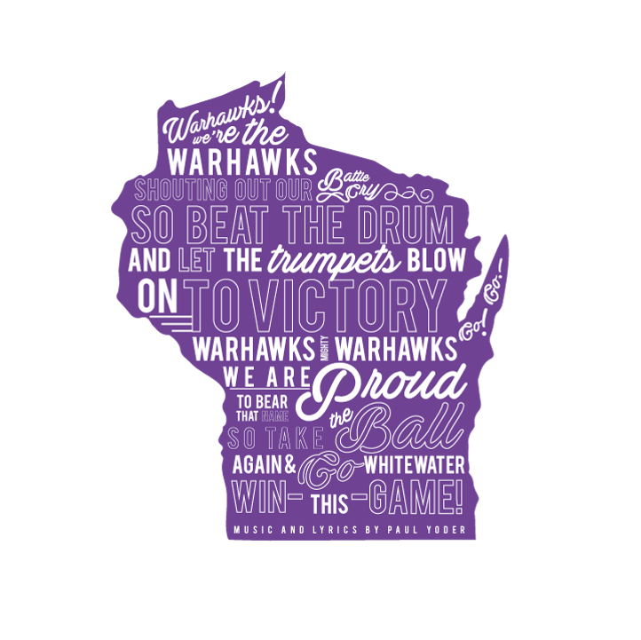
Questions/Comments?
Jodie Parys, Ph.D.
Professor of Spanish and
Community Based Learning Coordinator
University of Wisconsin-Whitewater
parysj@uww.edu
https://www.uww.edu/ce/cbl

