Slide 1
Creative Student Learning Outcomes Integrating Academic Identity and Teaching Practice.
Shamini Dias PhD
Claremont Graduate University • Lilly Conference 2020 San Diego

Slide 2
Workshop Outcomes
Explicitly articulate your core values and beliefs as a teacher-scholar.
Distinguish and generate both content- and future-capacity outcomes for a course.
Write a creative teaching philosophy that reflects your vision for meaningful student success in your discipline and in the future.

Slide 3
“… what I really want - in my heart of hearts – my students to learn”
Josh Ashenmiller, 2013
History Professor
https://www.historians.org/publications-and-directories/perspectives-on-history/january-2015/slo-curve-ball
Notes:
As scholars, passionate about the subject area we teach, when we think about teaching, we often have scholarly visions and values that we wish for our students. This quote taken from the article that is linked in the slides helps us connect with our passionate teacher-scholar vision of what it means to learn the subject we teach.

Slide 4
Discovering Passion Inside Your SLOs
What do you passionately care about in teaching your subject?
What brings you joy and lights you up?
Does writing SLOs excite and thrill you?
Do your SLOs contain the passion you feel about your subject?
Notes:
For some of us, there is a disjunct or break between the passion we feel about our scholarship and the teaching of it and the seemingly technical demands of Student Learning Outcomes.
If we really think about it, SLOs are not meaningless. In fact, from an ethical perspective of including all learners it makes sense to articulate the learning targets as clearly and as specifically as possible. Also, taking teaching-learning processes as a journey, the simple logic of a journey tells us that it is far more engaging and motivating for the students to know their journey destinations clearly before the embark on a journey. So, even putting aside institutional needs to have SLOs for their assessment processes, SLOs are a good teaching tool - it tells students what to aim for, it tells them exactly what they will be learning, and it creates a sense of purpose and direction.
Then .... why do we find building them so onerous? Sometimes, it is because they are given to us and seem to have no connection to our passion for our subject or for teaching. Sometimes it seems to be a meaningless exercise we must do to comply with the powers that be.

Slide 5
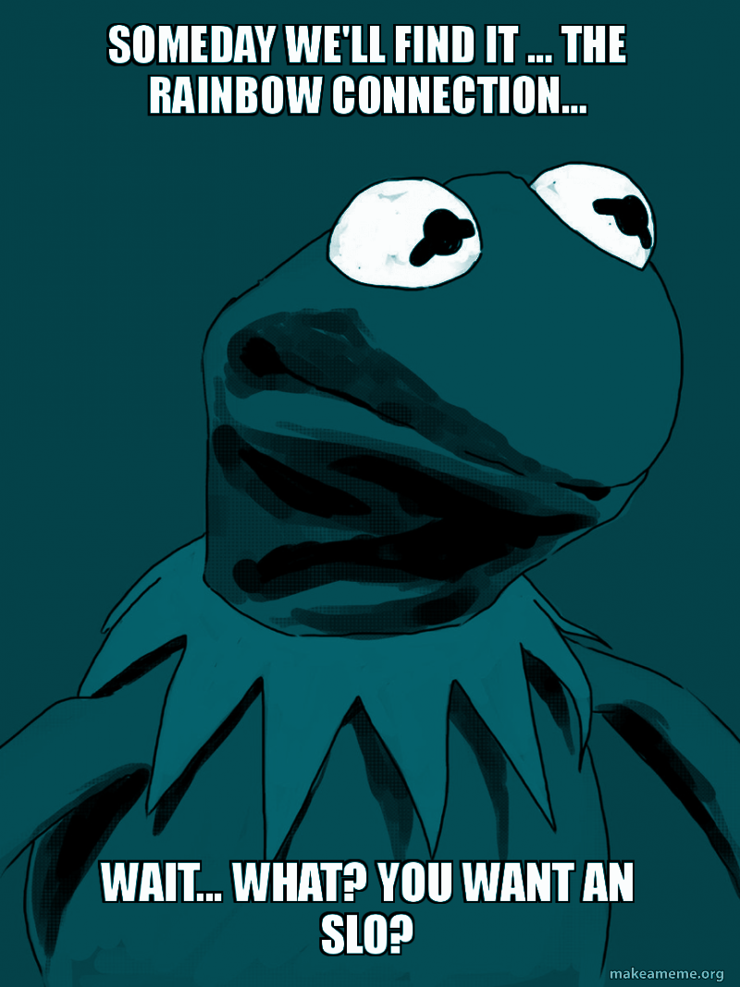
where does passion go when I write my SLOs?
is there room for ME in course design...
or do I resign myself
to cold technicality?
Notes:
Do we feel like this?

Slide 6
Passion
Meaningfulness
Student Learning
SLOs

Slide 7
SLOs
Passion
Meaningfulness
Student Flourishing
Notes:
Our goal is to integrate the idea of SLOs with our passion for our subject and our teaching, with meaningfulness to us as well as to our students, and with the idea that we do not just want students to learn our subject matter, but build capacities to flourish no matter what they go on to do.

Slide 8
Activity: Values and Visions - My Philosophy
Write words and phrases in response to the questions on the large paper in the room.
CONTENT OUTCOMES - The Passionate Teacher-Scholar
My values as a scholar - what brings me joy in my discipline?
What do I really care about for my students to learn?
CAPACITY OUTCOMES - Future-Focused Ethical Educator. Thinking about a fast-changing, unpredictable, diverse, and global future ...
What skills and capacities will my students need to flourish?
Notes:
CONTENT OUTCOMES - outcomes related to or based upon the subject matter that we teach. In terms of the subject matter of a course, what ought the students be able to know and to do by the end of the course. These are the SLOs are we most familiar with writing.
CAPACITY OUTCOMES - outcomes related to the students own development of skills and capacities that enable them to flourish and succeed in their futures. These might be things like Empathy, Learning How to Learn, Curiosity, Imagination, Teamwork Skills, Self-Expression, Discussion Skills etc. These outcomes transcend subject matter so that students will be able to work successfully in careers and their lives in an emerging unpredictable future.
We might be aware of some of these that our subject particularly lends itself to developing, but often we do not actually write these explicitly as SLOs. For example, if I am teaching an introduction to political science course which naturally gets into the role of government and citizens etc, the very teaching of this subject raises the notion of personal social responsibility that I can develop even as I teach the subject matter. But, if I recognize this and make it an explicit outcome with some activities/assignments focused on it (reflection papers for example), even if my students never go on to major in Political Science, they will take this awareness and capacity with them into whatever they do.

Slide 9
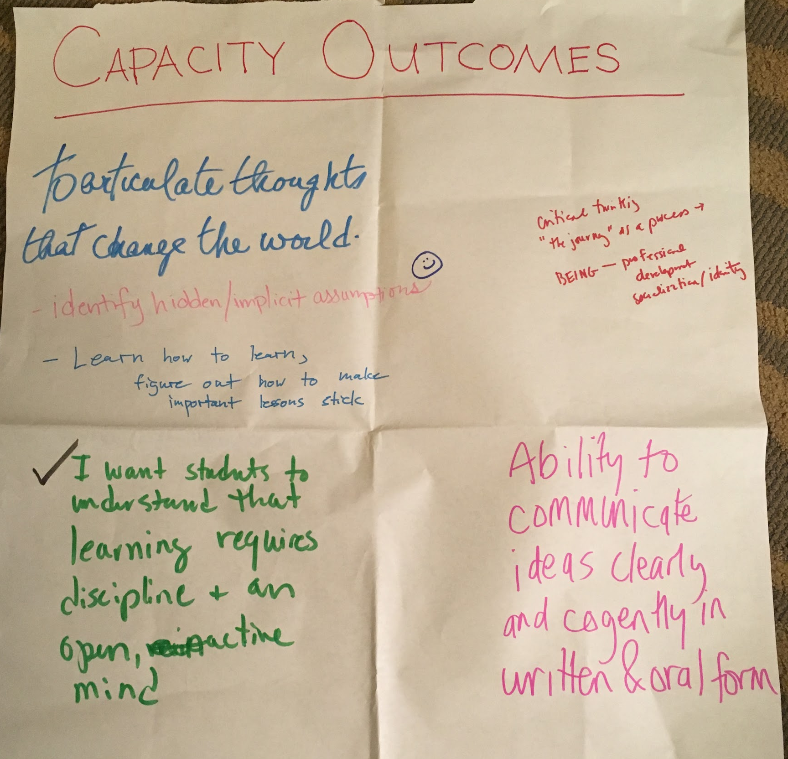
Notes:
These are the capacity outcomes we came up with in just 2 minutes.
It bears doing on your own again taking a little longer to more mindfully develop 2 - 3 capacity outcomes that are congruent to the subject and the approach you take in teaching. For example if your method generally is seminar discussions, you might want to build in a capacity outcome about Listening and Self-Expression ... that by the end of the course, students will be able to listen and respond to multiple perspectives with empathy. Writing an SLO makes you more explicit about what there is to gain from the process, and also enables you (and your students) to monitor if they are achieving this - through a mid-term and final reflection on this SLO. This builds metacognition of their mastery of this SLO.

Slide 10
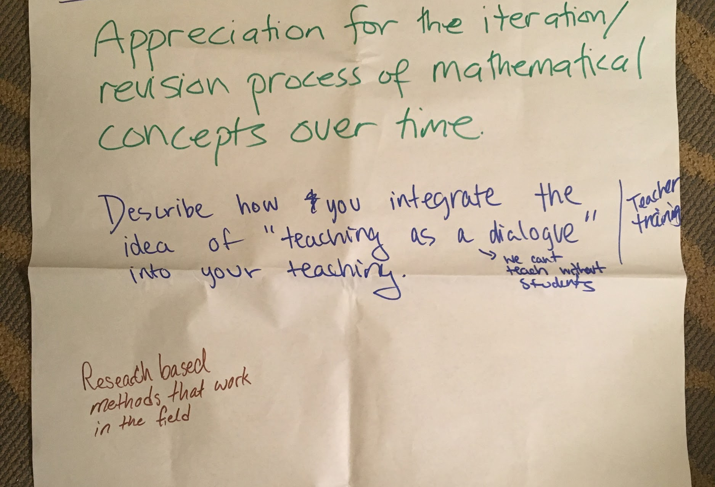
Notes:
Here are our Content outcomes - these are more familiar to us. Again, crafting these carefully just thinking of what it is in your heart of hearts you want your students to learn.
Note - crafting these and then asking - what are some capacity outcomes that might work well in how I plan to teach these content outcomes - can help generate your capacity outcomes.

Slide 11
Passionate Wishes for Student Learning … Ashenmiller’s WHY
MY Goals …….
I want my students to stumble out of the classroom in a daze, wobbling at the knees, because all of a sudden the world looks unfamiliar and strange.
I want them to wonder why they always heard so much about Rosa Parks, but next to nothing about Ida B. Wells and Homer Plessy.
I want them always to look for the date.
I want them to sense the depths of history—the feeling that we are just floating on the surface of a dark, mysterious ocean. All that we know about the shipwrecks on the ocean floor are the deductions we can make from pieces of flotsam and the reports of deep-sea divers.
Notes:
Here are the yearning, soaring goals Ashenmiller has for his students. These are his WHYs expressed with passion – we see his values as an educator clearly. We can think of these goals as reflecting his philosophy – his values and beliefs about learning and teaching, his mission and vision.
But these are not incompatible with creating clear directional outcomes that will help students take the journey he desires so passionately that they enter. Remember, from the student perspective – someone who has not yet found the passion the teacher so clearly feels – what the teacher seems to have as goals might feel daunting, abstract, and hard to relate to. Only someone as passionate about History would “get it”.
And so, as educators, we need to return to seeing it from the student perspective. Where are the students starting from and what do they need to help them take steps forward into this subject?

Slide 12
From WHY …………………………………………...To HOW
MY Goals ……. THEIR Learning
I want my students to stumble out of the classroom in a daze, wobbling at the knees, because all of a sudden the world looks unfamiliar and strange.
Find and articulate multiple perspectives on historical events
Connect themes in historical events to their lived experiences
I want them to wonder why they always heard so much about Rosa Parks, but next to nothing about Ida B. Wells and Homer Plessy.
Analyze and explain bias in historical representation
I want them always to look for the date.
Recall key events, dates, and chronology in _______ history.
I want them to sense the depths of history—the feeling that we are just floating on the surface of a dark, mysterious ocean. All that we know about the shipwrecks on the ocean floor are the deductions we can make from pieces of flotsam and the reports of deep-sea divers.
Imagine and create a deductive future history based on current events to reflect history’s incompleteness.
Notes:
This slide shows how it is possible to translate from the teacher’s WHY to HOW to get there - in language from a student’s perspective. Imagine is a student heard your passionate I want and asked, “so professor, what does that mean I will know how to do?”

Slide 13
Values Vision - WHY
Outcomes - HOW
WHAT
I want my students to stumble out of the classroom in a daze, wobbling at the knees, because all of a sudden the world looks unfamiliar and strange.
Find and articulate multiple perspectives on historical events
Connect themes in historical events to their lived experiences
Journalistic research
Role play video project
Role-play podcasts
Self-check quizzes
Co-created quizzes
Future history visual project - alternative timelines posters
sense of wonder - FINK: Caring
I want them to wonder why they always heard so much about Rosa Parks, but next to nothing about Ida B. Wells and Homer Plessy.
Analyze and explain bias in historical representation
Inquiry, critical thinking
Recall key events, dates, and chronology in _______ history.
I want them always to look for the date.
Precision, rigor, Bloom: remember
I want them to sense the depths of history—the feeling that we are just floating on the surface of a dark, mysterious ocean. All that we know about the shipwrecks on the ocean floor are the deductions we can make from pieces of flotsam and the reports of deep-sea divers.
Imagine and deduce multiple future histories based on current events.
Sense of wonder, imagination, curiosity
creative thinking
Notes:
Here you see the key words highlighted in the “I want” statements - the translation to student-focused outcomes, and examples of the kinds of assignments/activities possible that go beyond the standard midterm and final exams and papers to include multiple modalities (builds information literacy) and plays to student’s use of different ranges of skills.
The Outcomes are annotated with the different levels of learning using Bloom’s Fink’s and LEAP outcome frameworks so you can see how these “I wants” range across different levels of learning.

Slide 14
Activity: Write and Translate
In my heart of hearts, what I really want my students to learn | Translation to SLOs students will understand
CONTENT
CONTENT
FUTURE-CAPACITY
FUTURE-CAPACITY

Slide 15
Activity: Creative Teaching Philosophy
I want my students to open a new window to the world
I want my students to master learning
I want my students to understand that error is ok and very much welcomed.
Nothing has to be perfect the first time around.
I want my students to develop ways to work together in critical engagement and camaraderie.
I want my students to be empowered so they can teach themselves.
I want students to learn a methodical approach in problem solving and critical thinking in engineering.
I want my students to explain their positions and beliefs and provide evidence and examples to support their position. I want my students to critically analyze the messages being delivered in texts of what is acceptable in race and gender roles. ... to question everything; to decolonize and think critically.
I want my students to imagine boldly and wildly.
I want my students to feel.

Slide 16
Activity : SLO Passion Collage
Write one of your passion statements on a strip of paper.
Meet someone - read aloud your statement.
Exchange statements. Now you have someone else’s statement
Repeat meeting - reading - exchanging statements.
Stand in the space.
Read aloud the statement you have in your hand.
I will collect all the statements and create a poem to send to you.

Slide 17
I want my students to learn self-identity
I want my students to understand their lives are the result of historical (and current) events. And yet, they are responsible to create a more just world.
... to articulate their thoughts effectively
... to articulate their thoughts in order to change the world.
to make the change they want to see made in the world.
I want my students
to respectfully engage in critical conversations.
to relish having the opportunity
to express their thoughts and analyses in written form.
I want my students to understand the pieces of knowledge that will help them succeed
... and allow that to resonate
... and cut through the B.S.
I want my students to feel and wield the force of reason.
I want students to develop professional self-efficacy.
to think and stand on their own as future teachers.
to view teaching as a dialogue with students.
I want my students to be
effective social entrepreneurs and leaders in non-profit organizations.
I want my students to be impacted
and come into their own.
Individual lines created by workshop participants at Lilly 2020 San Diego. Collage created by Shamini Dias

Slide 18
Reflection
How do your deep values and passion as an educator enter your classroom and your facilitation of learning? What might you do to deepen how you integrate your disciplinary passion, your educator values and aspirations, and your day to day teaching?

Slide 19
Questions
Thoughts
Ideas

Slide 20
Questions
Thoughts
Ideas

