Slide 1

Integrating interactive video lectures into a hybrid research methods course
Timothy M. Ottusch
University of Arizona

Slide 2
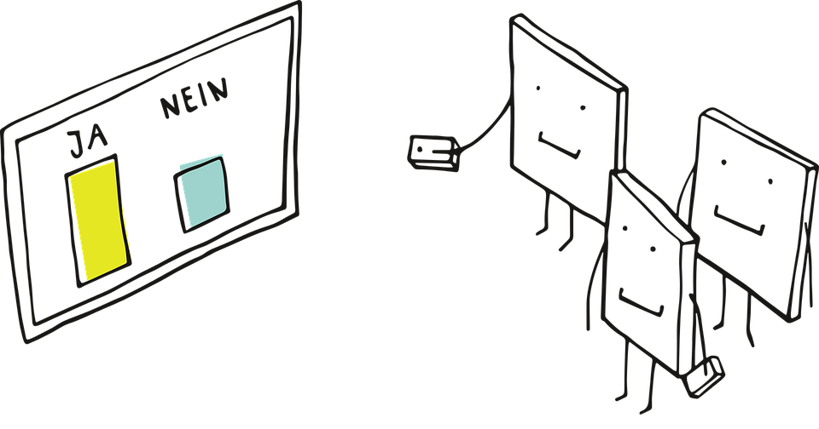
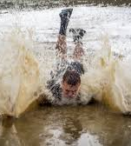

Agenda

Slide 3
Personal responses systems (PRSs) and learning
The use of PRS (i.e. clickers) in face-to-face classes generally has been associated with better academic outcomes (Fitpatrick et al., 2011; Gauci et al., 2009; Hunsu et al., 2016).
Students report being more engaged and attentive in-class (Poirier et al., 2007)
Studies report students appreciate the opportunity for feedback on their understanding of the material (Milner-Bolotin et al., 2010)

Slide 4
Interactive Video Lectures
Less is known on the implementation of PRS style activities in online video lectures
One study found student appreciated the immediate feedback when in-video quizzes were used in a flipped computer program class (Cummins et al., 2015)
Schoenner and Tiili (2016) utilized IVLs in a physics course and students reported more prepared for labs compared to written instructions

Slide 5
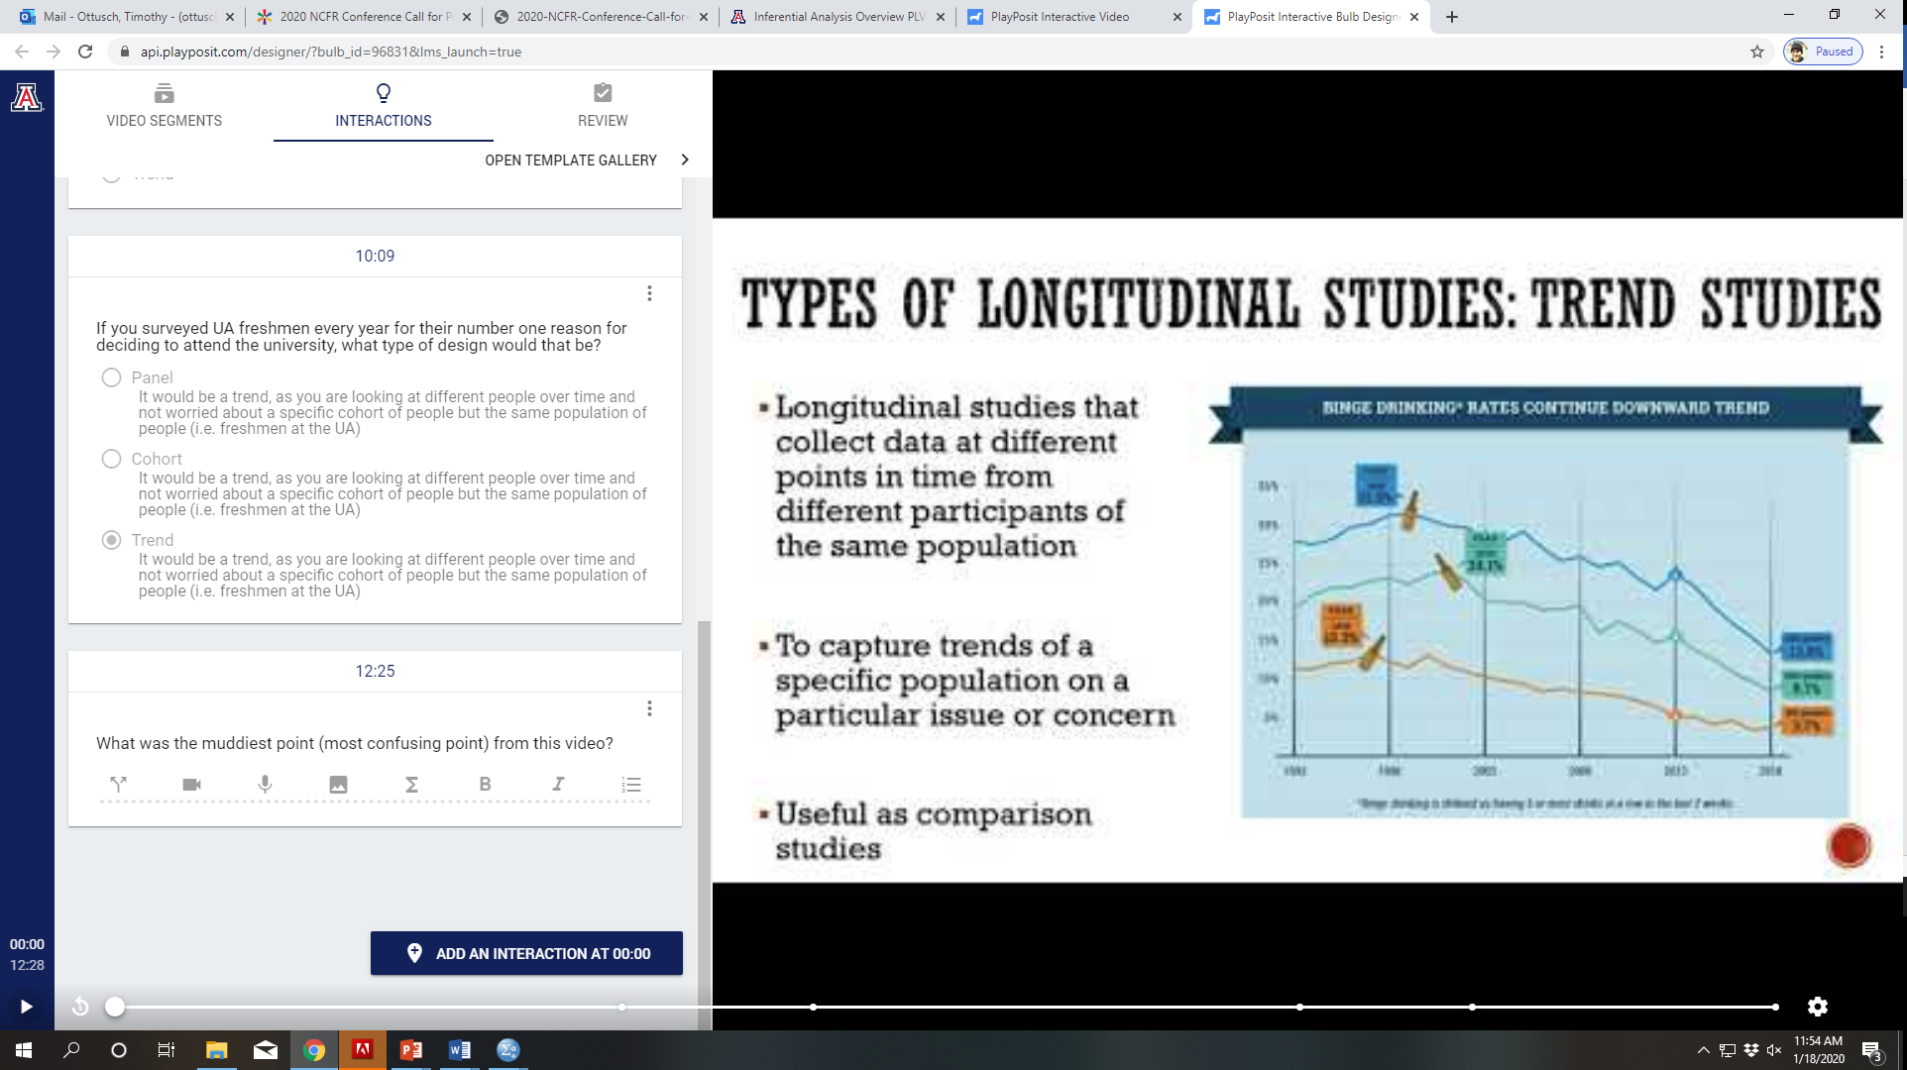
PlayPosit

Slide 6
How might you include an IVL in one of your courses?
This may be a fully online, hybrid, flipped or fully F2F class

Slide 7

The muddiest point
The muddiest point asks, in some way, what the most confusing (i.e. muddiest) point from the lecture, session, or topic.
It provides an easy to way to see common areas of confusion
It can also help guide future class sessions (Angelo & Cross, 1993)

Slide 8
The current study
The current study sought to students’ perspectives on the inclusion of interactive video lectures (IVLs) into two Family and Consumer Science hybrid research methods classes.
It also includes how ILV responses guided class sessions, the muddiest point question in each ILV.

Slide 9
Methods
Interactive video lectures (IVLs) were implemented in two Family and Consumer Science research methods courses in the Spring and Fall of 2019
Each were hybrid and met face-to-face from 11-11:50 a.m. on Wednesdays
Students completed the IVLs by 11:59 p.m. Tuesday
The professor and undergraduate teaching assistant reviewed the ILV responses on Wednesday morning.
The responses, particularly from the muddiest point question at the end of each video lecture, helped guide the in-class session

Slide 10
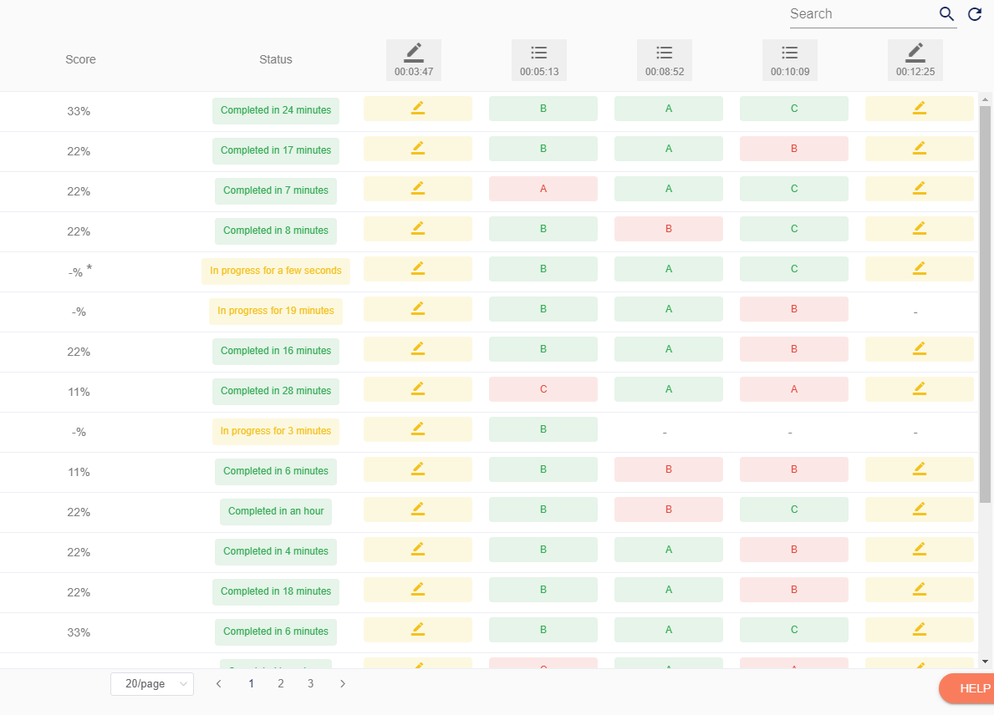
PlayPosit

Slide 11
Methods
Interactive video lectures (IVLs) were implemented in two Family and Consumer Science research methods courses in the Spring and Fall of 2019
Each were hybrid and met face-to-face from 11-11:50 a.m. on Wednesdays
Students completed the IVLs by 11:59 p.m. Tuesday
The professor and undergraduate teaching assistant reviewed the ILV responses on Wednesday morning.
The responses, particularly from the muddiest point question at the end of each video lecture, helped guide the in-class session

Slide 12
Methods
An anonymous survey through Qualtrics was given to each section of the class in the final two weeks of the class
It solicited their feedback on the ILVs (See handout for items) and the in-class session, as well as the assignments, quizzes, and overall structure
Most questions were likert style (1= strongly agree to 7= strongly disagree)
Open-ended questions included “what aspects of the PlayPosit videos did you find to be particularly helpful in your learning?”
Quantitative analysis was performed in SPSS

Slide 13
Results: Demographics
Sample size: 86 respondents
Major:
59.3% Retail and Consumer Science
30.2% Family Studies and Human Development
10.5% Other
Gender:
83.7% Female
Age:
M= 20.19 (SD= 1.06)
Class:
2.3% Freshmen
44.2% Sophomore
51.2% Junior
2.3% Senior
Hybrid Course Experience:
65.9%
Notes:
Prior experience with a hybrid class: 65.9%
Previous experience with video lectures in a class: 60.7%
Previous experience with interactive video lectures: 51%

Slide 14
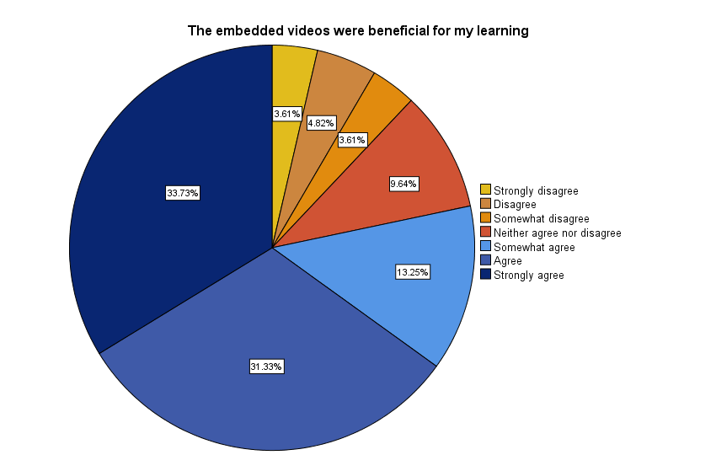
Results

Slide 15
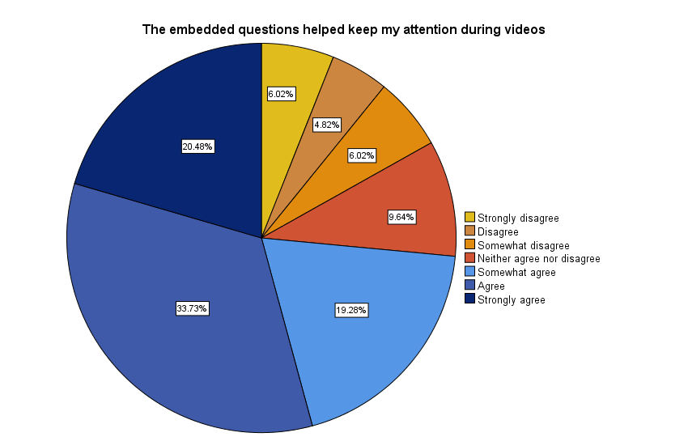
Results

Slide 16

Results

Slide 17
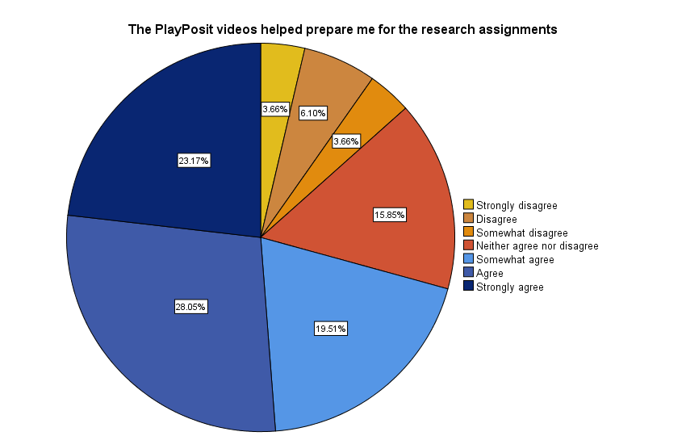
Results

Slide 18
Results
Rankings of the helpfulness of the questions types in the ILVs
Multiple choice (91.6%)
Check all that apply (75.9%)
Fill in the blank (69.9%)
Free response (66.3%)
Reflective pauses (53.%)

Slide 19
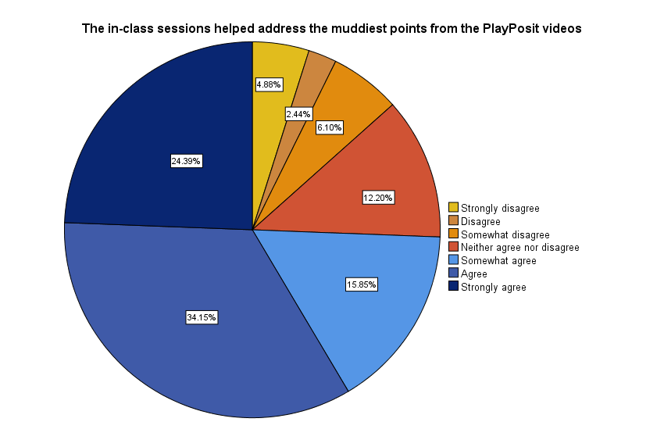
Results
Notes:
Most helpful for learning: In-class; Lecture; Muddiest point
Least helpful for leanring: Muddiest point; Lecture; In-Class

Slide 20
Do you already include the muddiest point in your classes?
How do you include it?
How might you include it (if you don’t) or include it more?
What issues have you faced when including it?

Slide 21
Drawbacks/Critiques
Students didn’t like free response questions when no feedback was offered
The students didn’t report actually engaging with the reflective pauses
Length and quality (Keep it to about 10 minutes)

Slide 22
Suggestions
Provide a feedback loop for all question types
The muddiest point question helps decipher different issues section to section
Show students you covered their muddiest point

Slide 23
Thank you
Questions?
ottusch@email.arizona.edu

